Slide 1
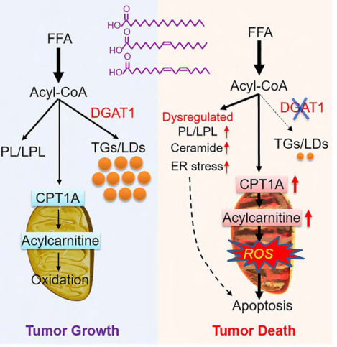
With DGAT1 active (left): excess FFAs are esterified into TGs and stored in lipid droplets, preventing lipotoxicity and supporting tumor growth.
With DGAT1 inhibited (right): FFAs are diverted into mitochondrial oxidation via CPT1A, causing lipid imbalance, ER stress, ceramide accumulation, ROS production, and apoptosis → tumor cell death.
Cheng X, Geng F, Pan M, Wu X, Zhong Y, Wang C, Tian Z, Cheng C, Zhang R, Puduvalli V, Horbinski C, Mo X, Han X, Chakravarti A, Guo D. Targeting DGAT1 Ameliorates Glioblastoma by Increasing Fat Catabolism and Oxidative Stress. Cell Metab. 2020 Aug 4;32(2):229-242.e8. doi: 10.1016/j.cmet.2020.06.002. Epub 2020 Jun 18. PMID: 32559414; PMCID: PMC7415721.
20250930

Slide 2
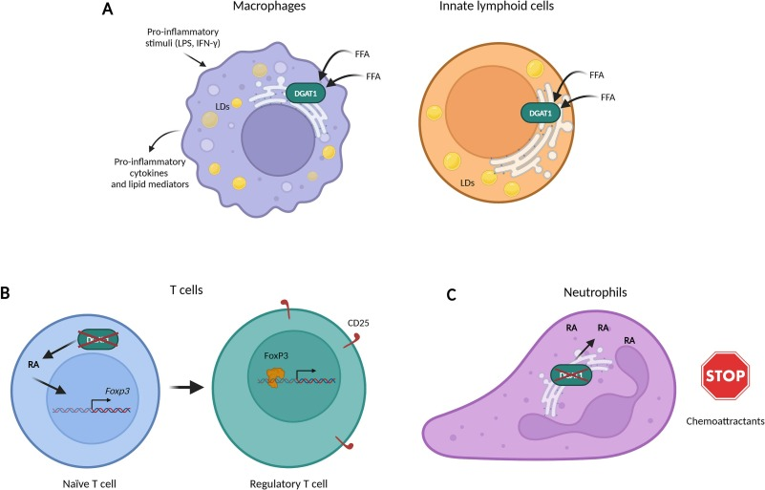
A. Macrophages & Innate Lymphoid Cells
DGAT1 → lipid droplet (LD) formation from FFAs
Supports production of pro-inflammatory cytokines & lipid mediators
👉 Effect: Pro-inflammatory / immune-activating
B. T cells (Treg differentiation)
DGAT1–RA axis drives Foxp3 expression → Treg development (CD25+, FoxP3+)
👉 Effect: Immunosuppressive (Treg expansion dampens effector immunity)
C. Neutrophils
DGAT1 deficiency → excess RA → impaired chemotaxis toward chemoattractants
Normal DGAT1 = enables neutrophil migration
👉 Effect: DGAT1 loss = suppressive (reduced neutrophil infiltration)
Immunomodulatory activity of DGAT1
Oleszycka, E., Kwiecień, K., Grygier, B., Cichy, J., & Kwiecińska, P. (2025). The many faces of DGAT1. Life Sciences, 362, 123322. https://doi.org/10.1016/j.lfs.2024.123322
20250930

Slide 3
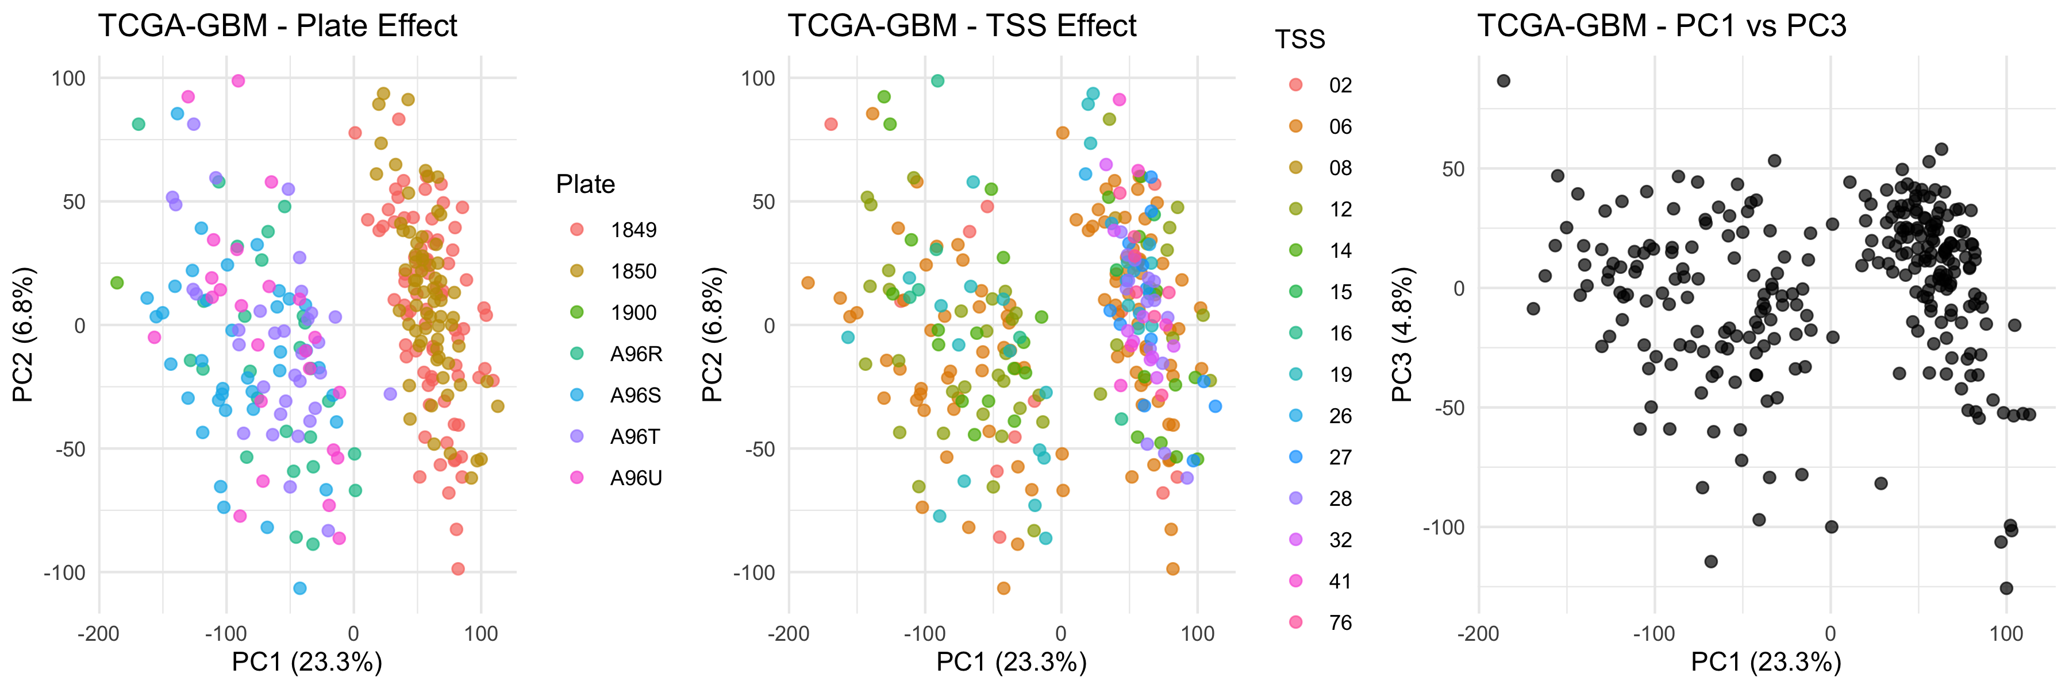
20250930

Slide 4
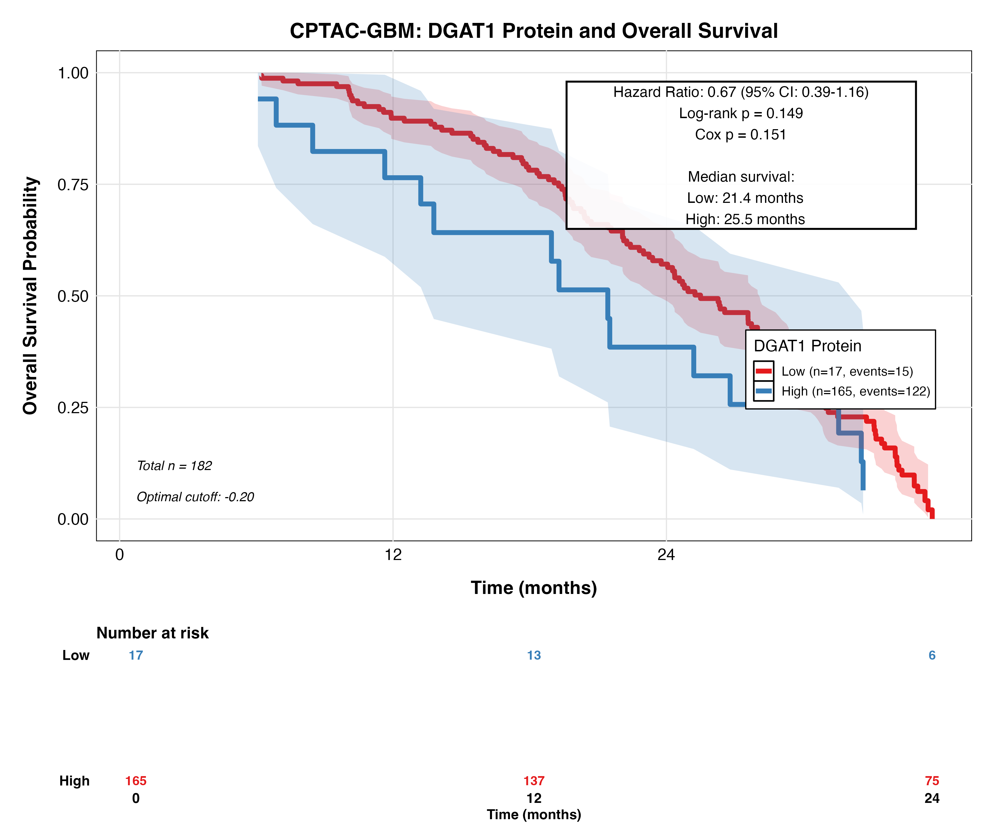
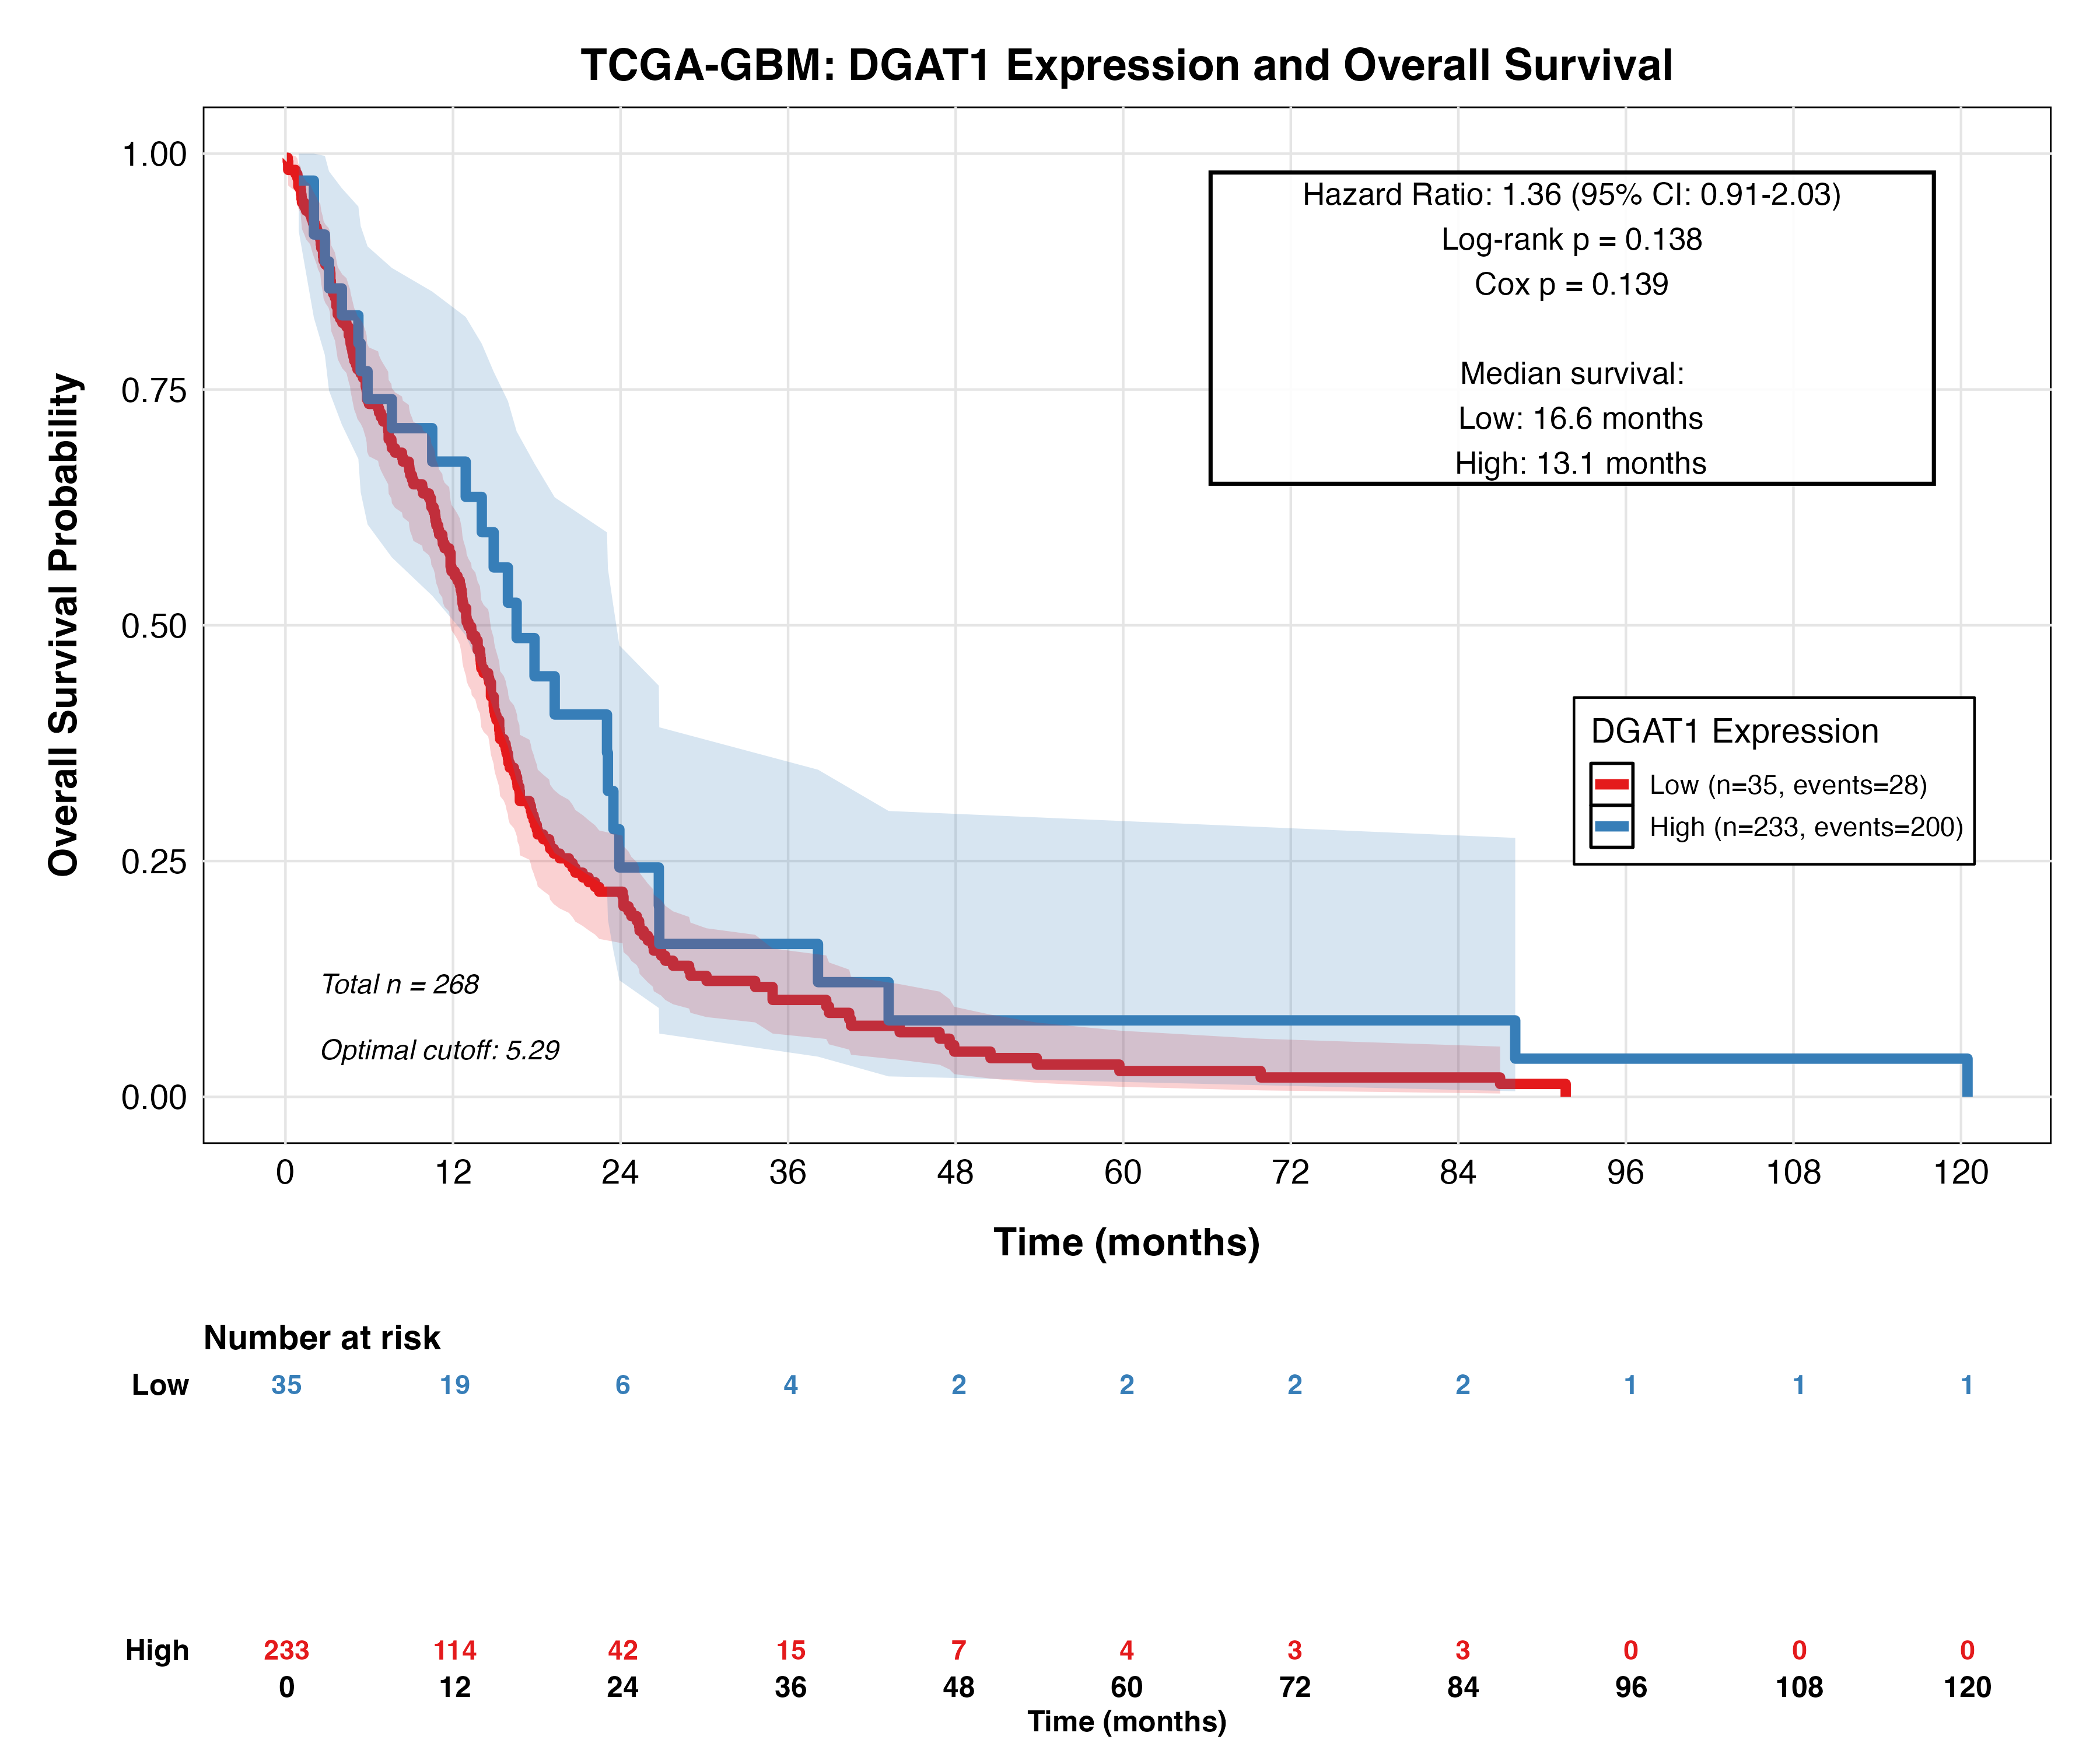

Slide 5
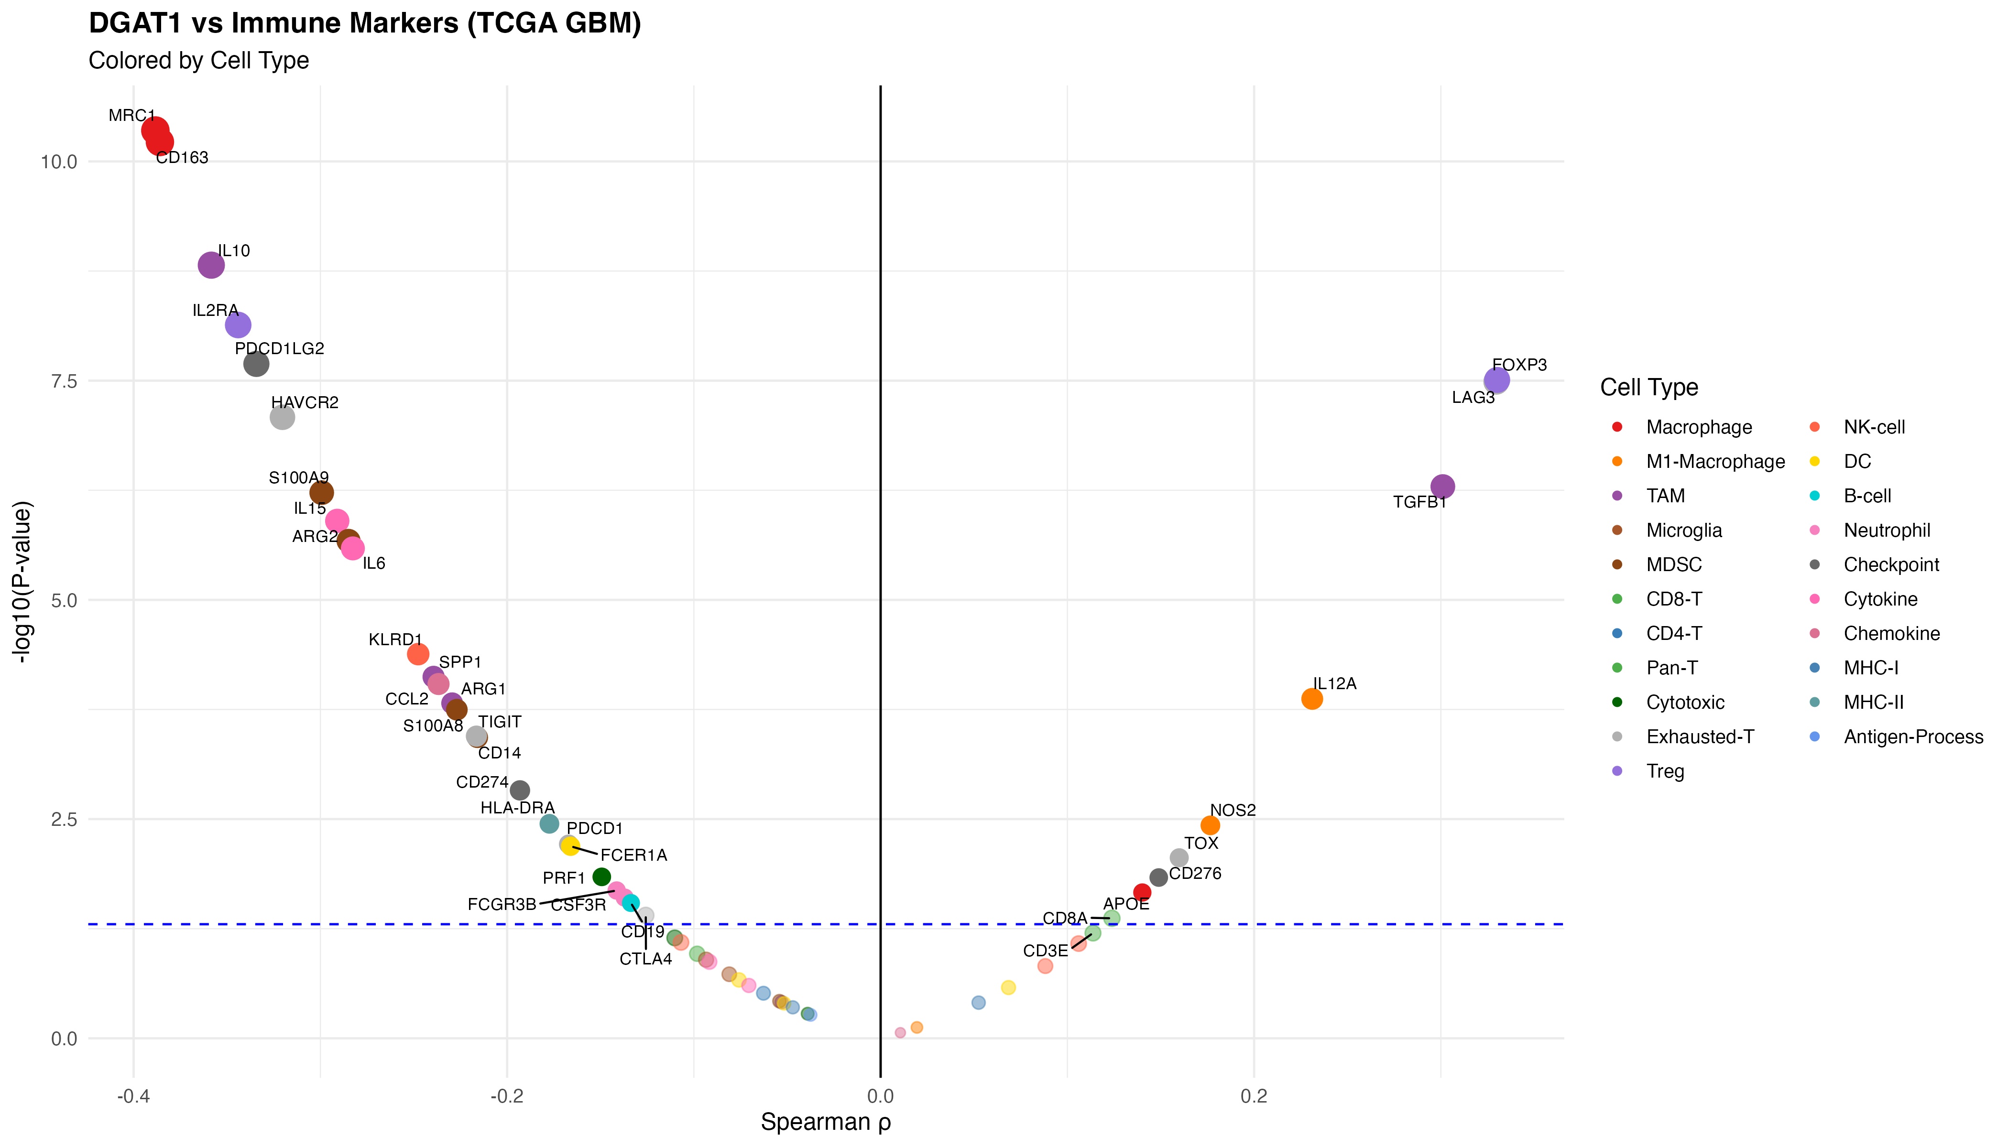
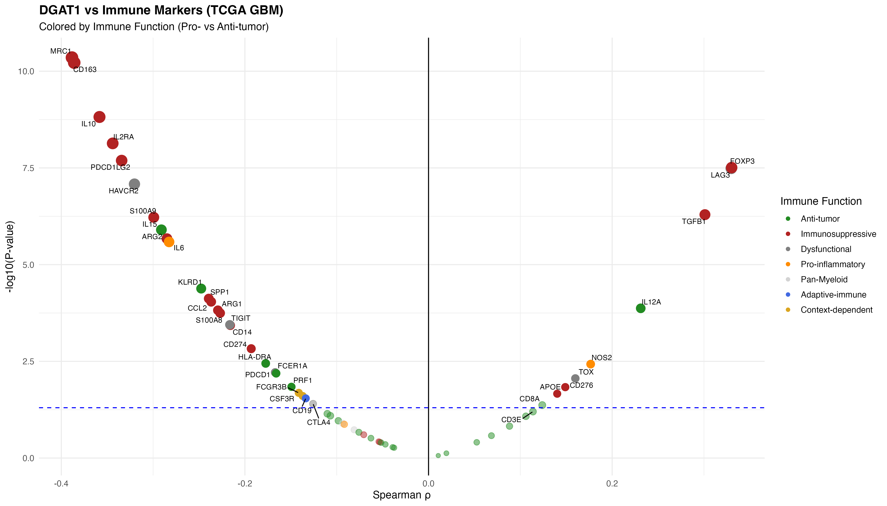
20250929
Key Points:
57 immune markers analyzed across 268 GBM samples
Strong negative associations with M2/TAM markers (left side):
CD163, MRC1 (ρ ≈ -0.39, FDR < 0.001) - M2 macrophages
IL10 (ρ = -0.36, FDR < 0.001) - Immunosuppressive cytokine
S100A9 (ρ = -0.30, FDR < 0.001) - MDSCs
Positive associations with Treg markers (right side):
FOXP3 (ρ = +0.33, FDR < 0.001)
LAG3 (ρ = +0.33, FDR < 0.001) - Exhaustion marker
Key Points:
Immunosuppressive markers (red): Negative correlations (17/20 significant)
M2, TAM, MDSC, checkpoint markers reduced in DGAT1-high
Anti-tumor markers (green): Limited associations (6/23 significant)
Weak negative trends for CD8 T cell and NK markers
Dysfunctional markers (gray): Mixed patterns (5/6 significant)
Complex T cell exhaustion signatures

Slide 6
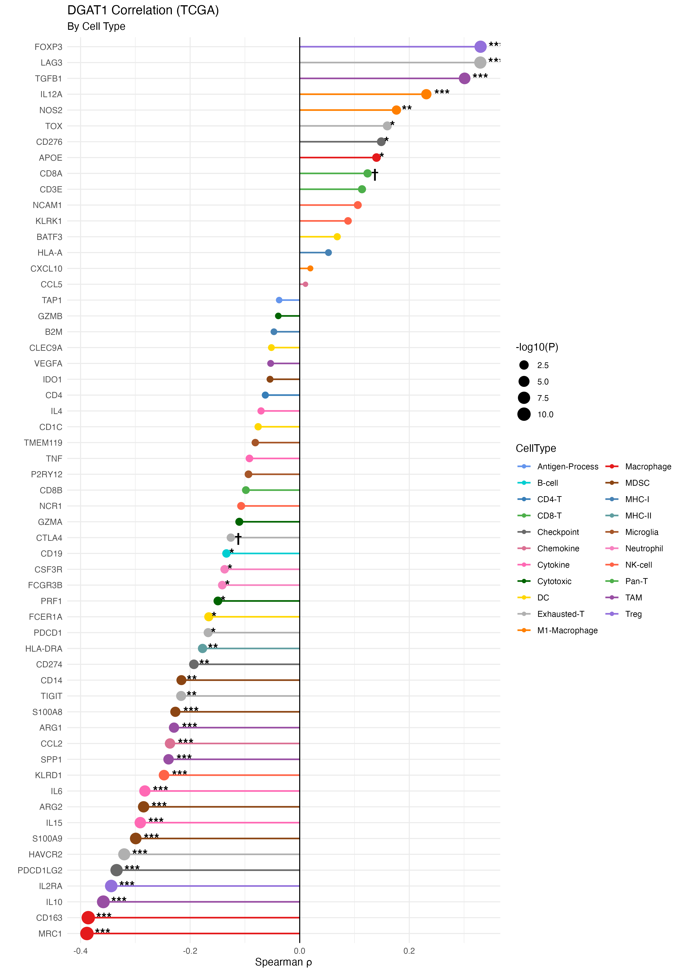
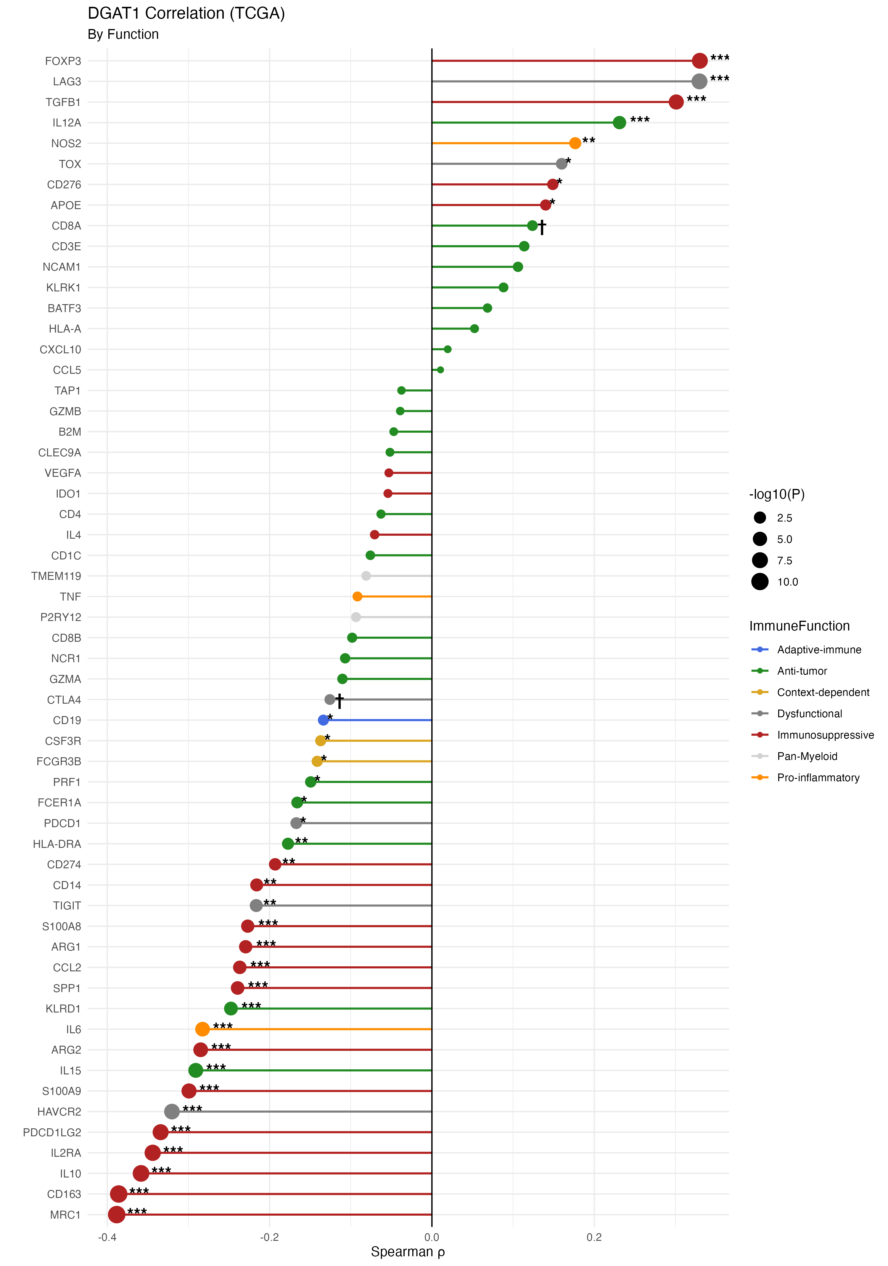
20250930
Strongest negative (left, **):
CD163, MRC1 (M2 macrophages)
IL10 (TAM suppression)
IL2RA (Treg activation)
PDCD1LG2 (PD-L2 checkpoint)
Strongest positive (right, **):
FOXP3 (Treg master TF)
LAG3 (T cell exhaustion)
TGFB1 (TAM cytokine)

Slide 7
20250930
DGAT1 expression inversely correlates with M2 macrophage and TAM immunosuppressive markers (33/57 markers FDR < 0.05), suggesting DGAT1-high GBM tumors may have reduced myeloid-mediated immunosuppression

Slide 8
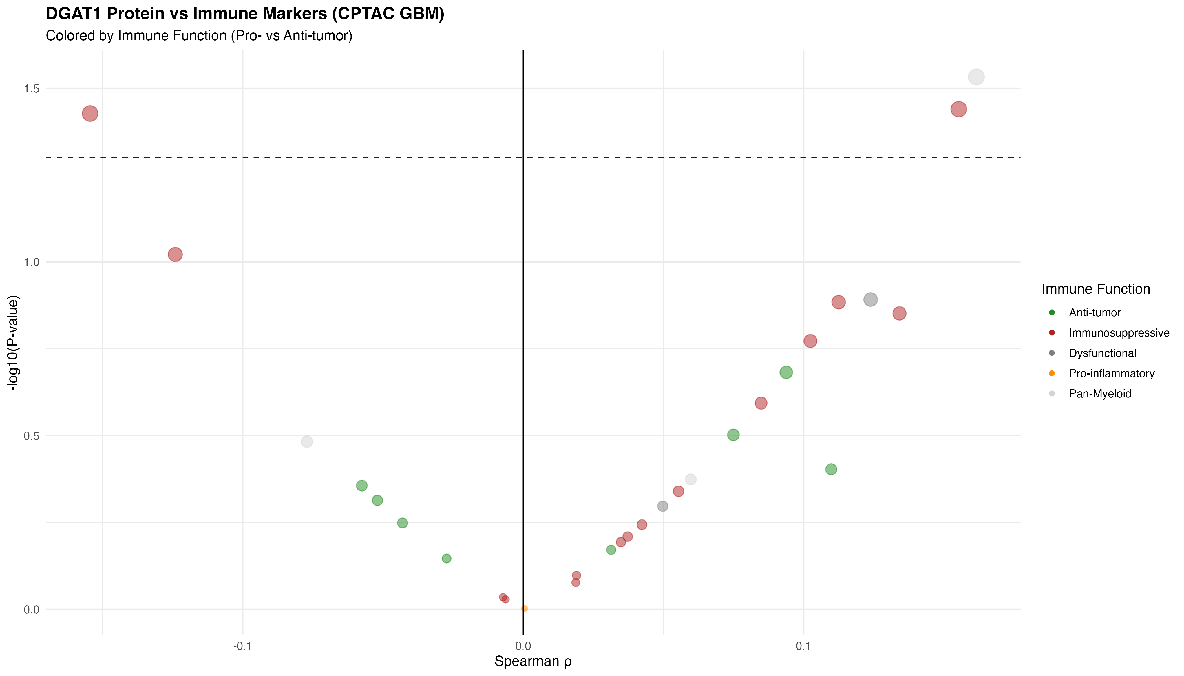
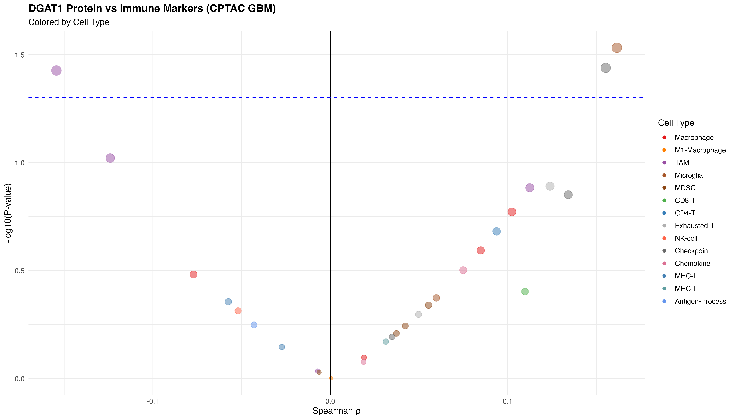
20250930

Slide 9
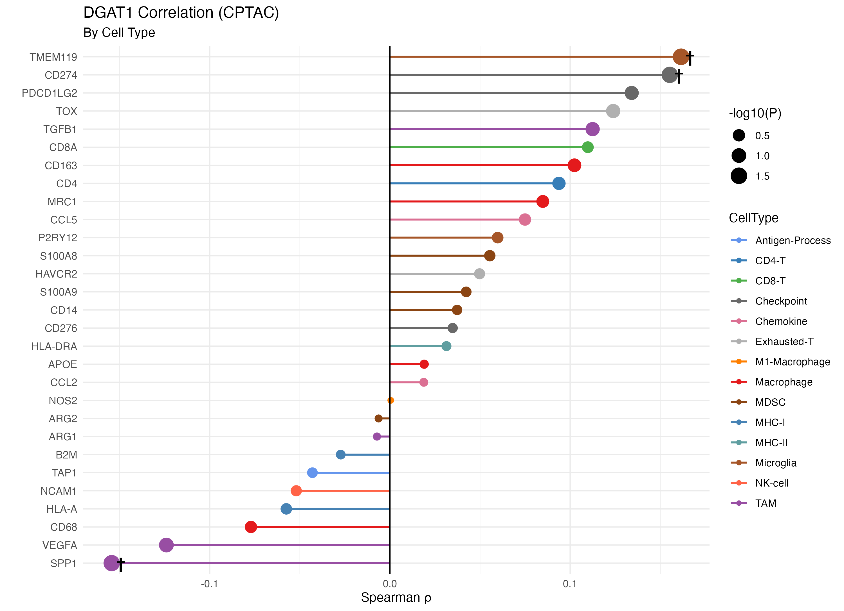
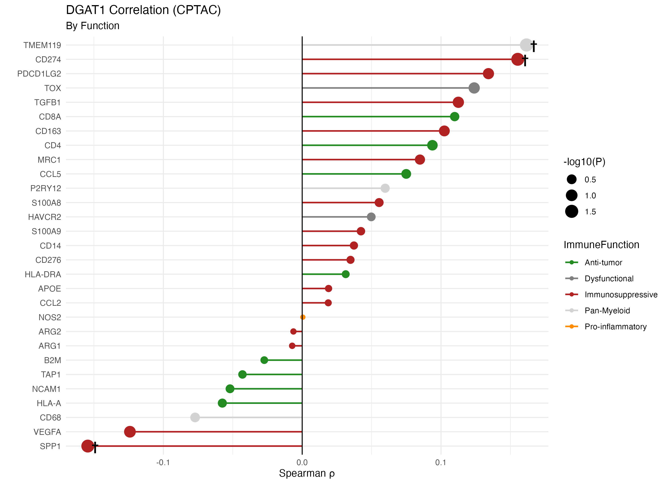
Opposite trends:
TCGA: CD163, MRC1 strongly negative (ρ ≈ -0.39)
CPTAC: CD163, MRC1 weakly positive (ρ ≈ +0.10)
Possible explanations:
Post-translational regulation differences
Limited proteomics sensitivity for immune proteins
Different patient cohorts
20250930

Slide 10
Cross-Platform Comparison Box:
Feature | TCGA (mRNA) | CPTAC (Protein)
Coverage | 93.4% | 47.5%
Significant | 33 markers | 0 markers
Top correlation | CD163 (ρ=-0.39) | TMEM119 (ρ=+0.16)
M2 pattern | Strong negative | Weak positive

Slide 11
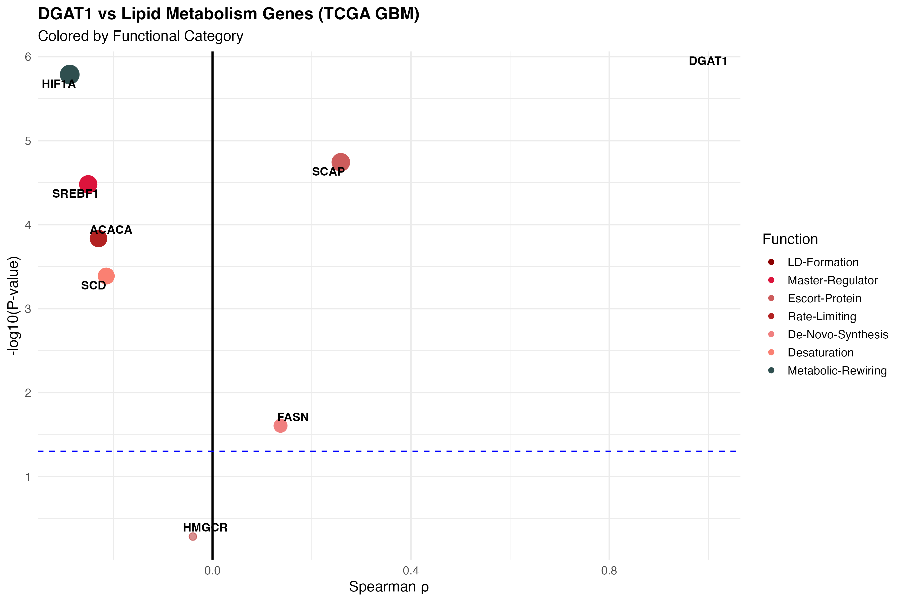
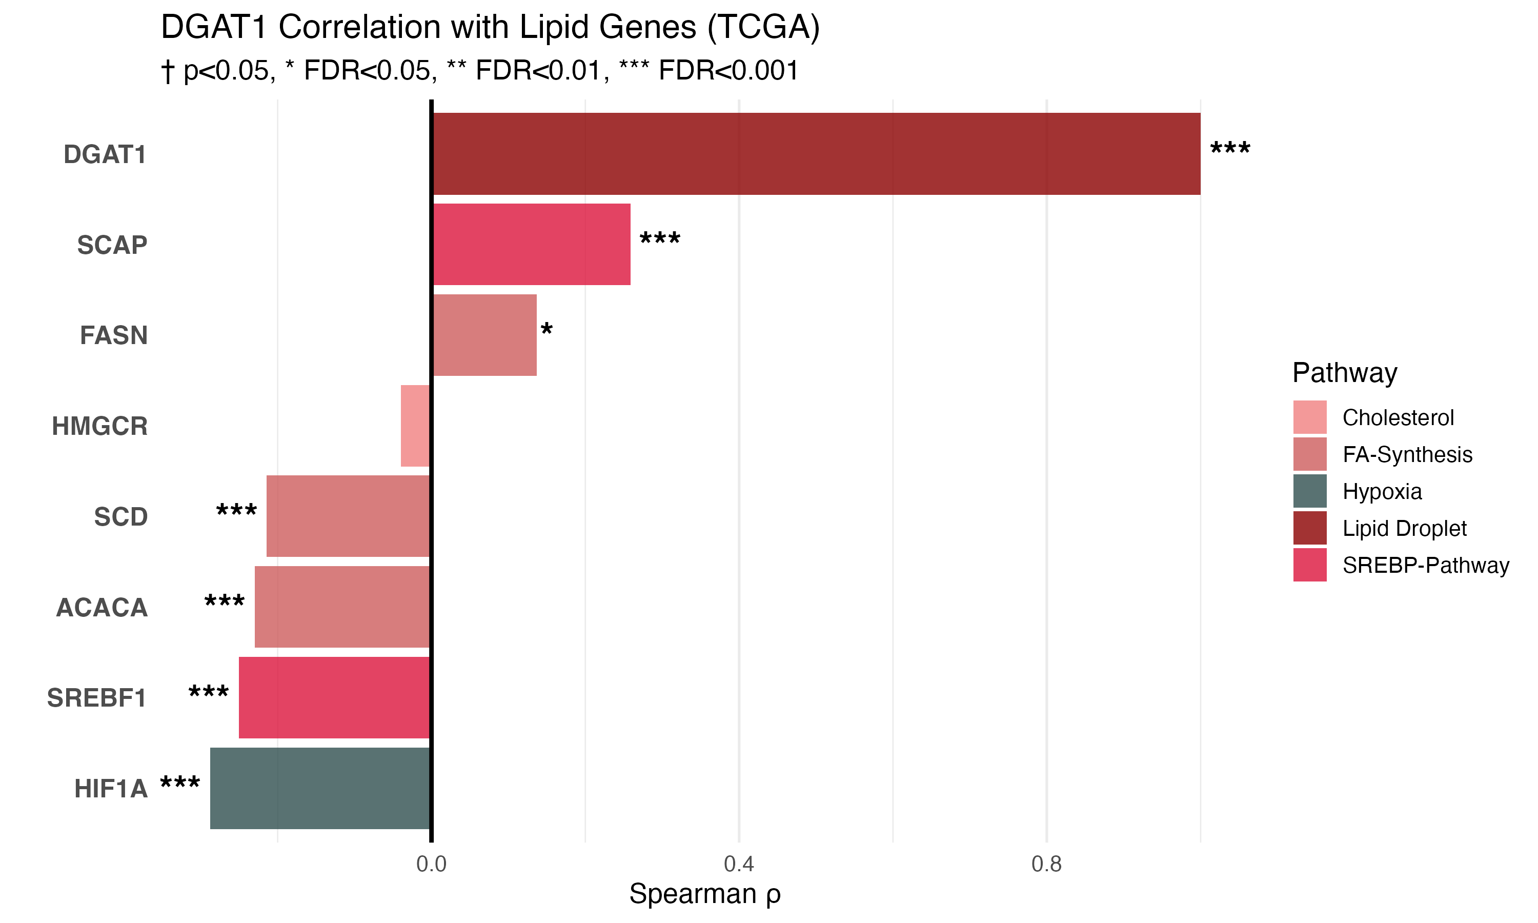

Slide 12
Thanks!

Slide 13
Only two papers provide robust experimental evidence that DGAT1 drives immunosuppressive TAMs: Wu et al. 2019 offers the strongest mechanistic proof in colon cancer models, PubMed Centralnih while He et al. 2021 provides clinical validation in gastric cancer patients. PubMed Central +5 Claims that "DGAT1 inhibition increases CD8+ infiltration" are not supported by current literature—in fact, the opposite was observed. nihPubMed Central The relationship between DGAT1 and tumor immunity centers almost exclusively on macrophages, Nature +2 leaving T cell biology unexplored. This represents both a significant limitation of current knowledge and an opportunity for future investigation.

Slide 14
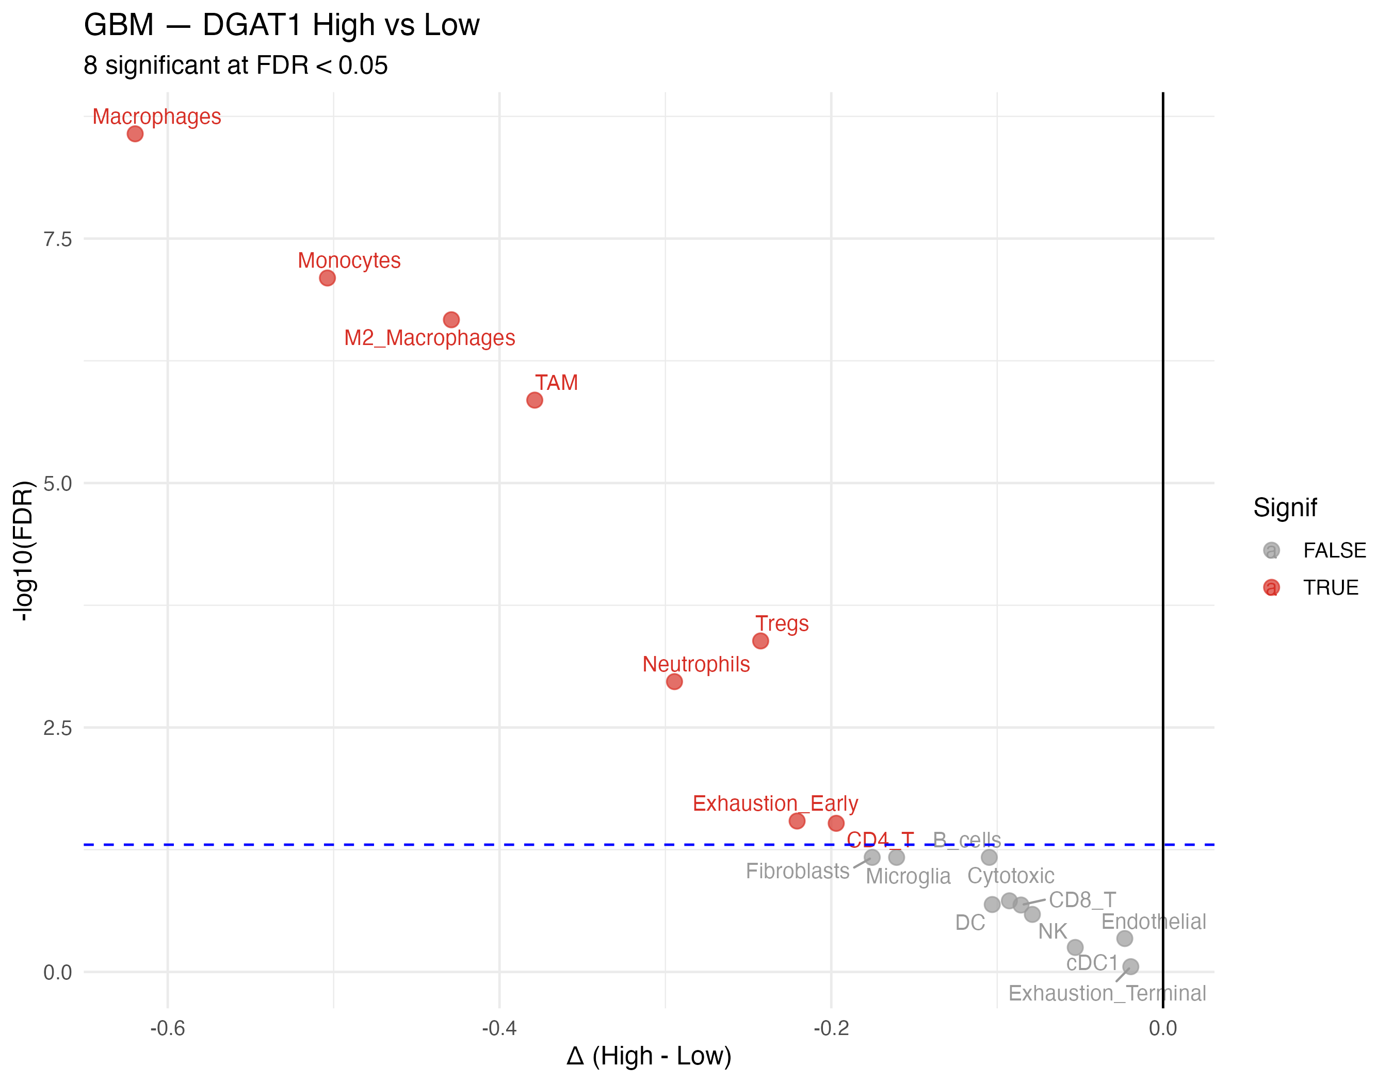
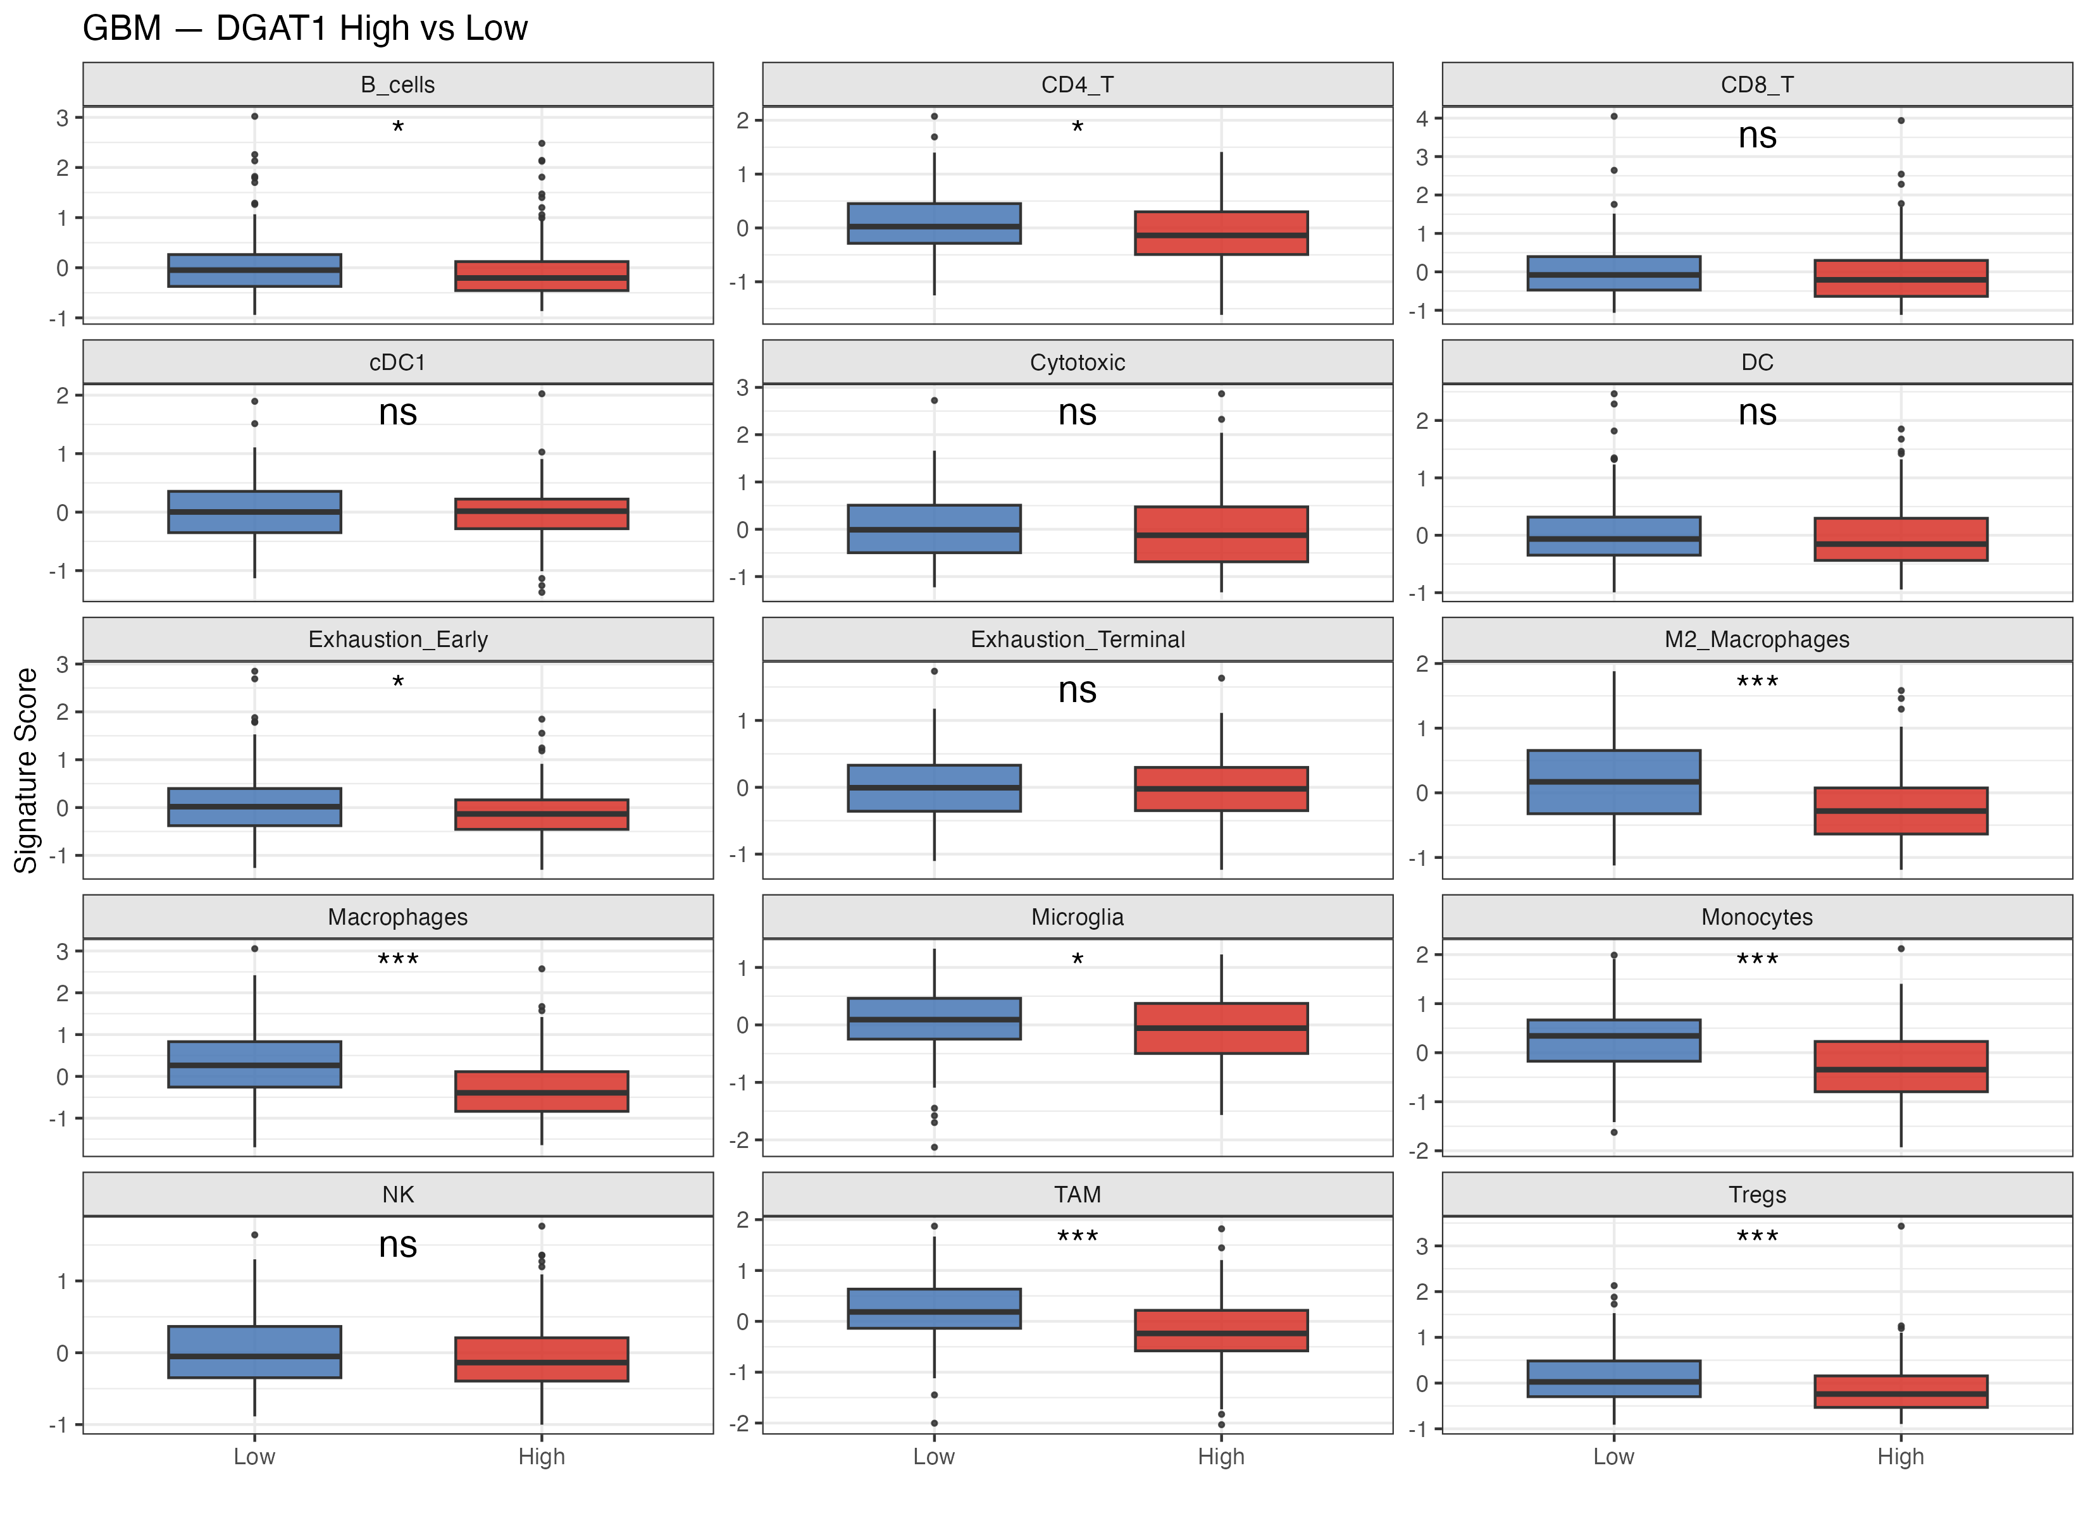

Slide 15
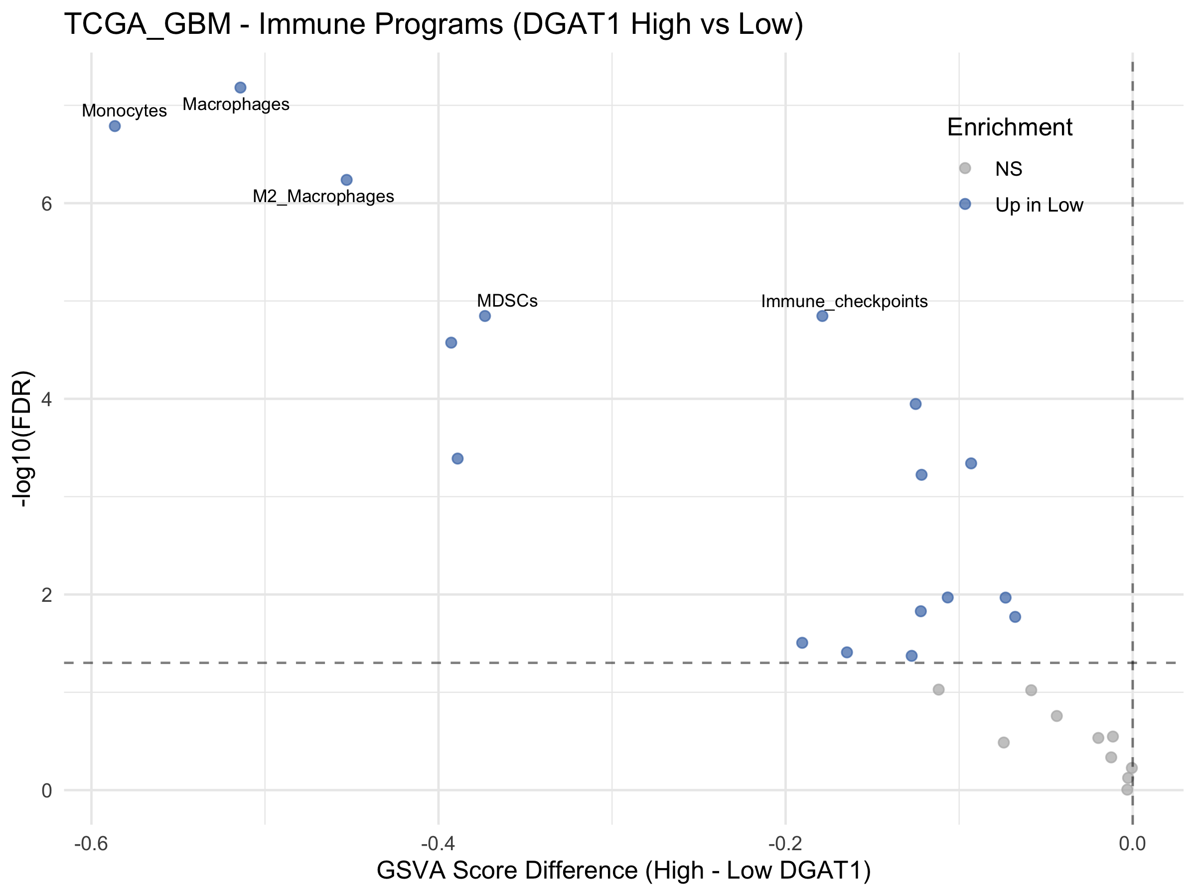
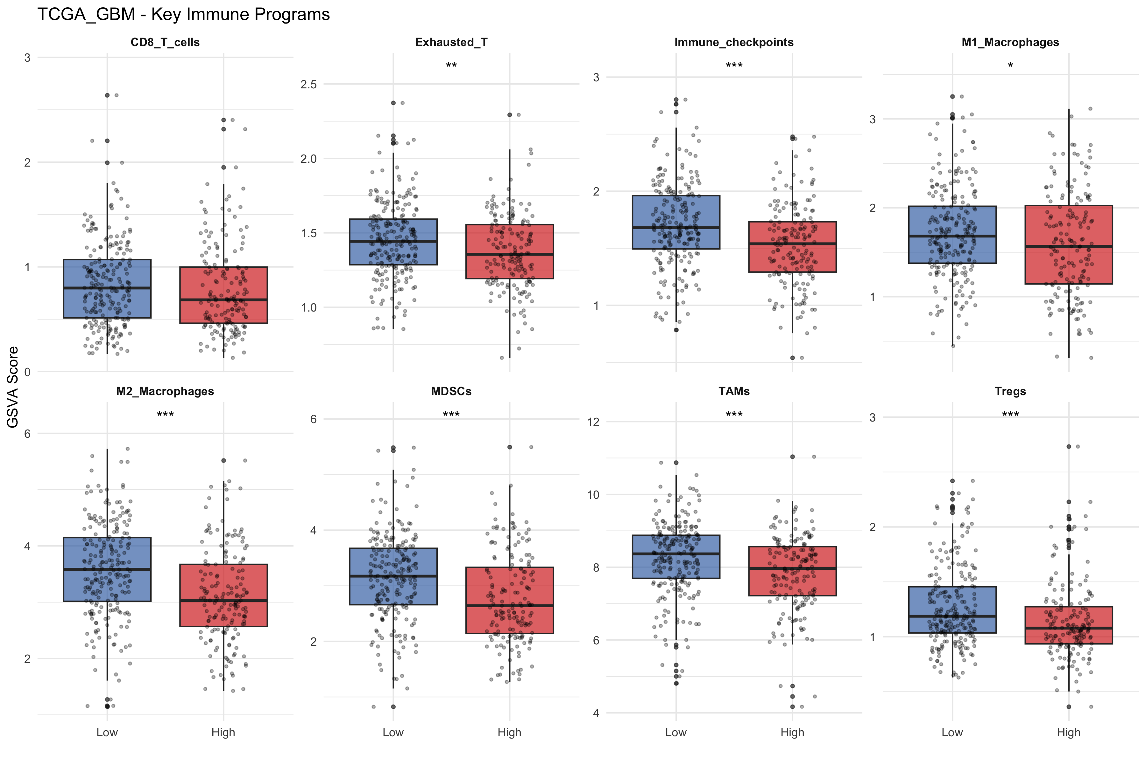

Slide 16
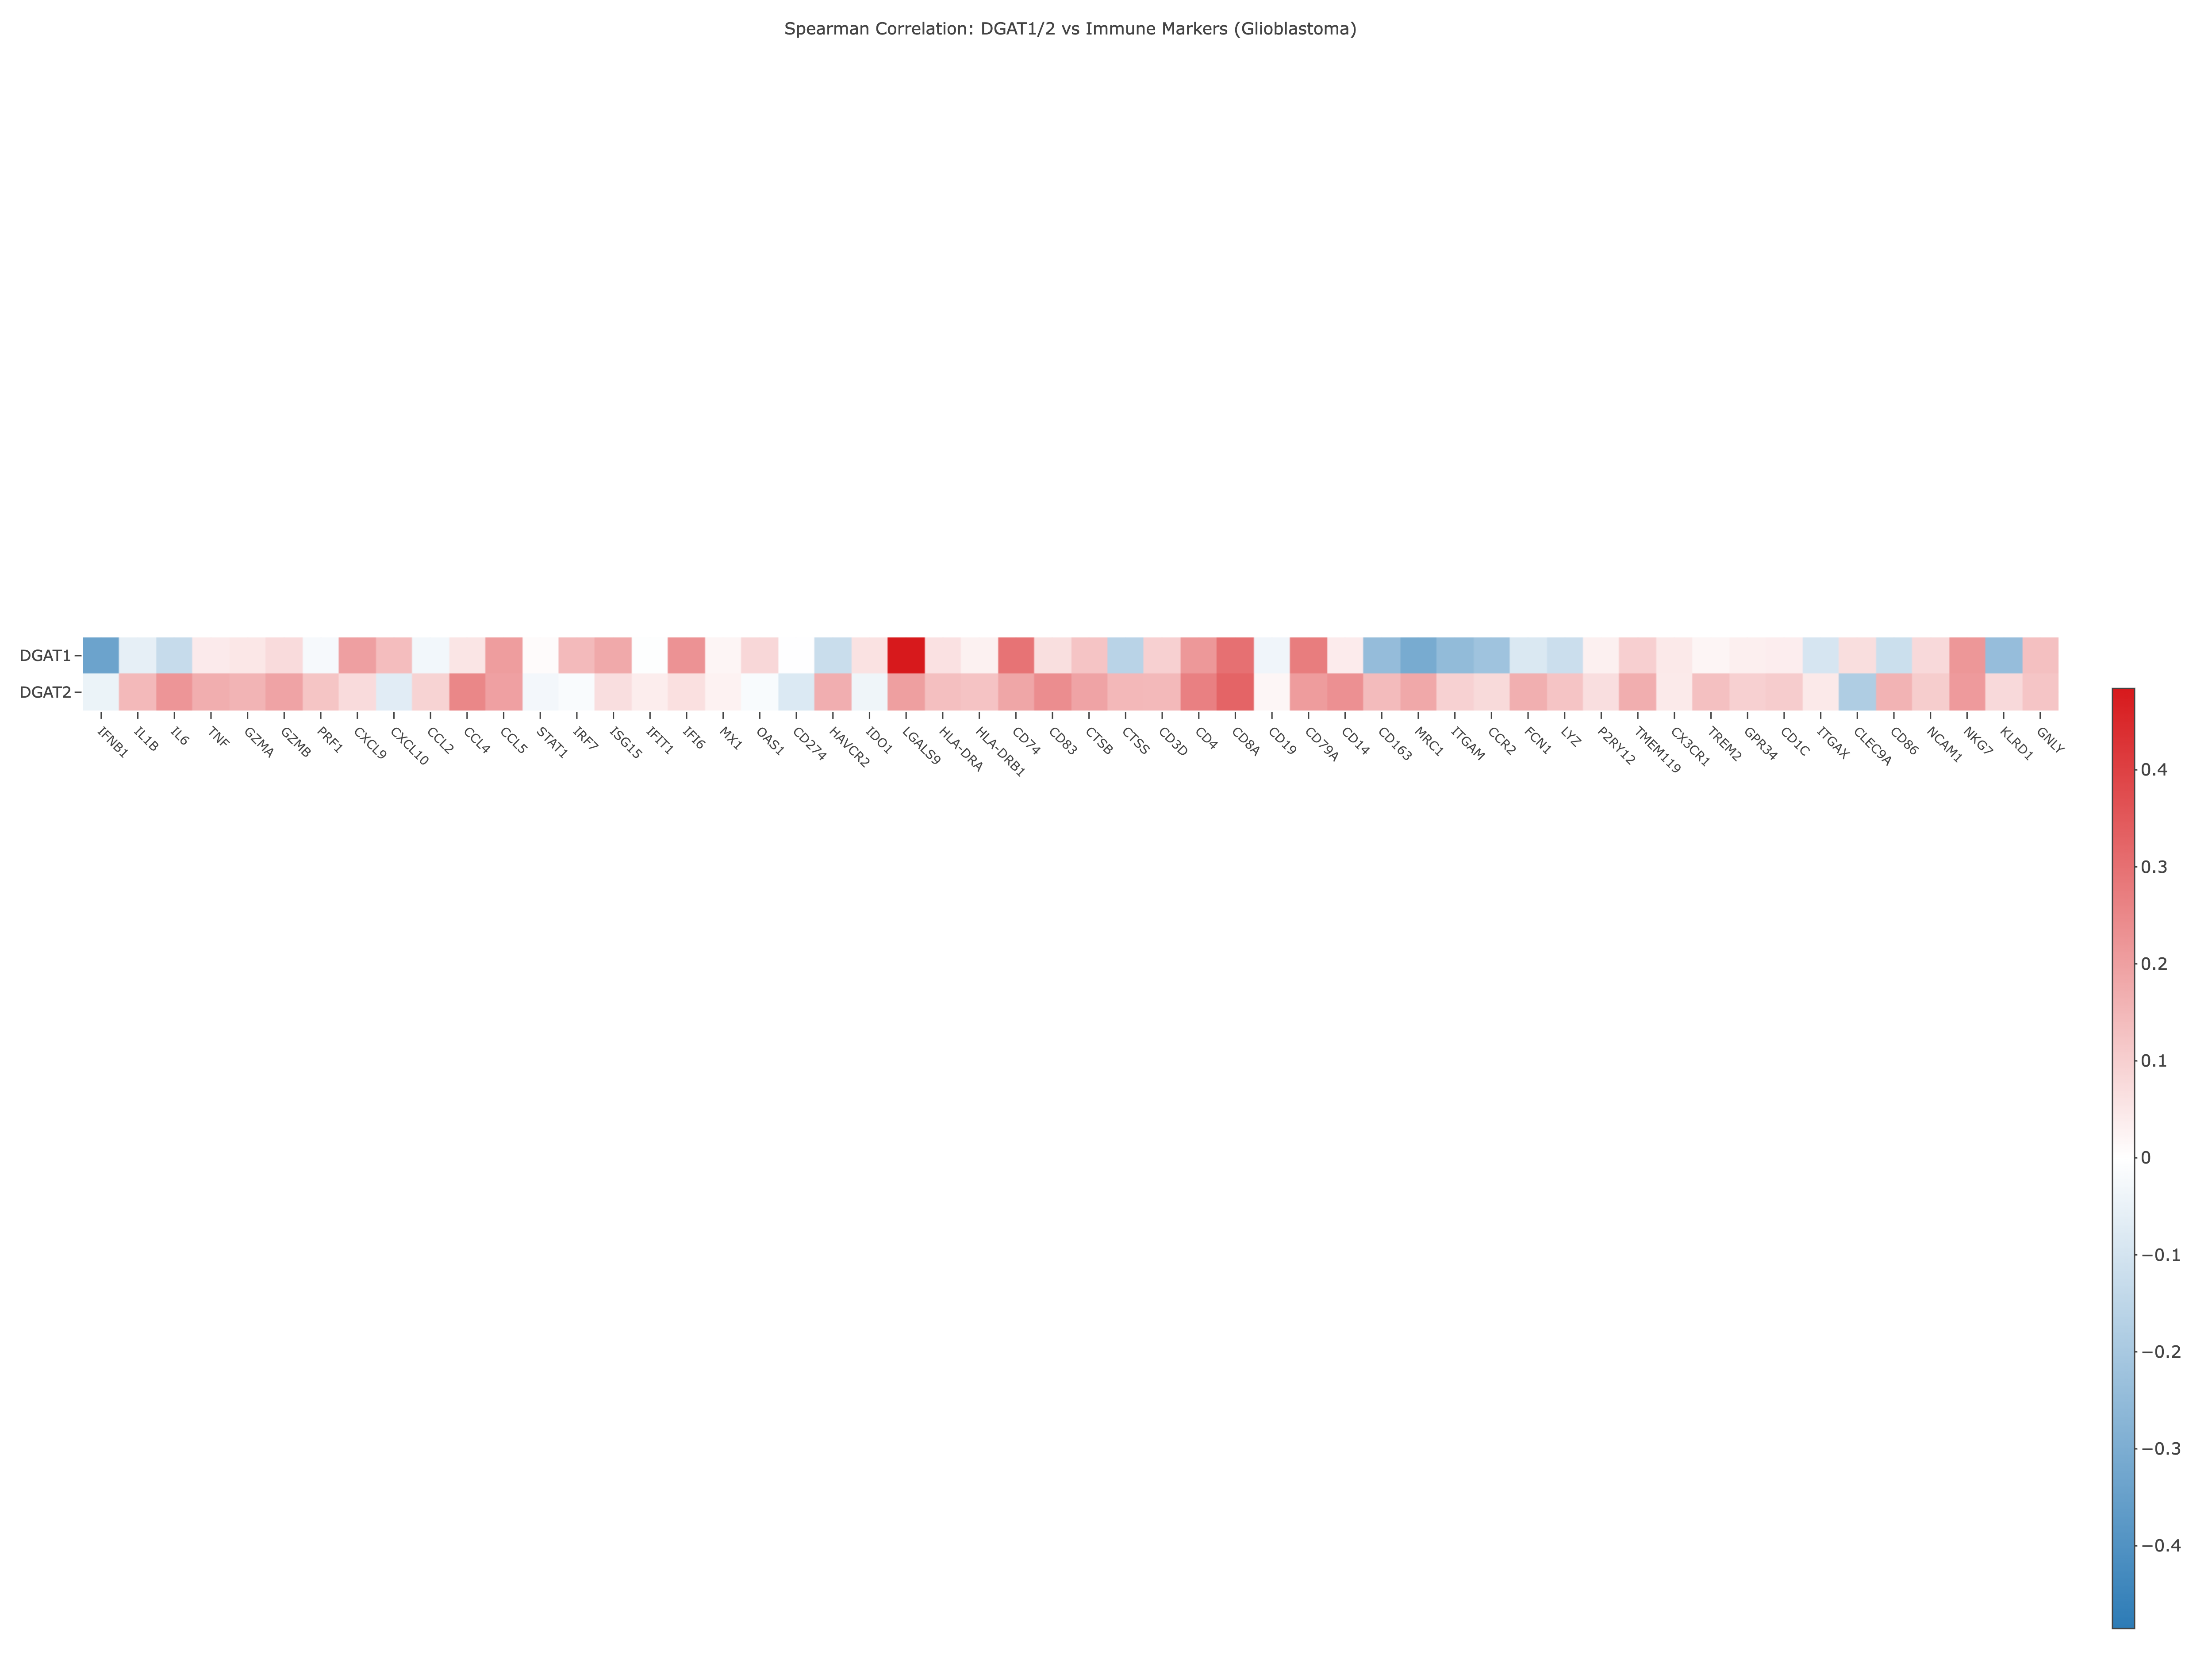
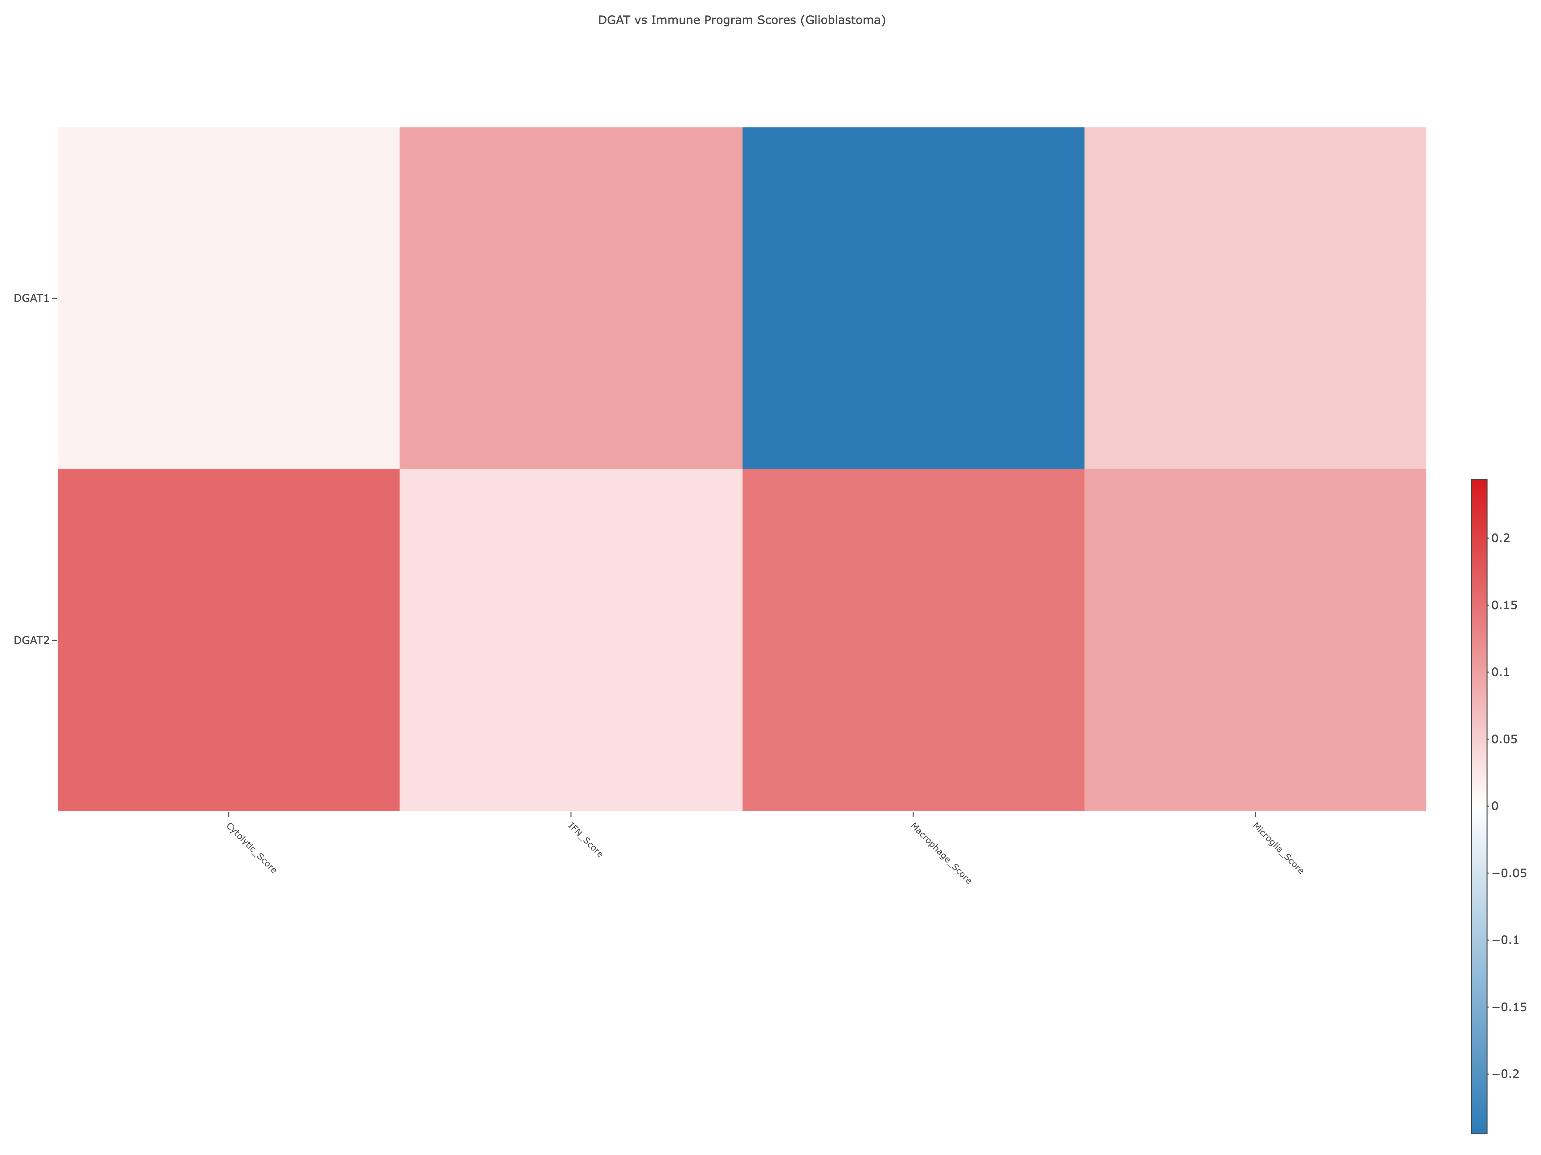
20250929

Slide 17
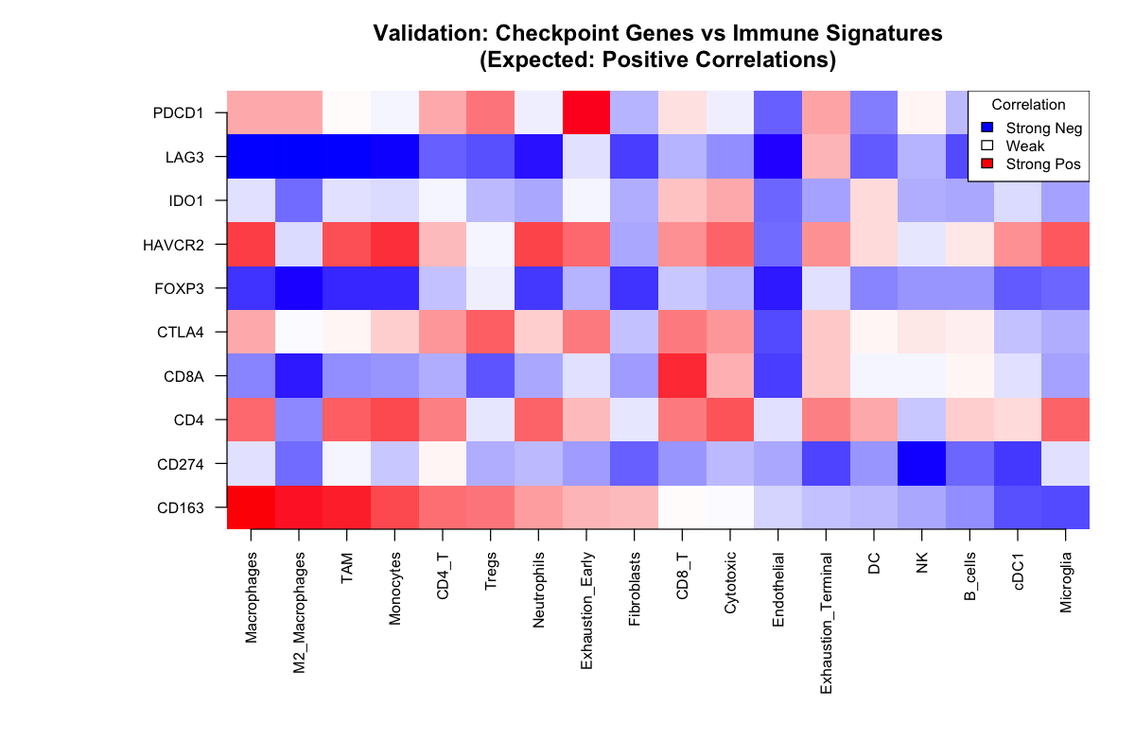

Slide 18
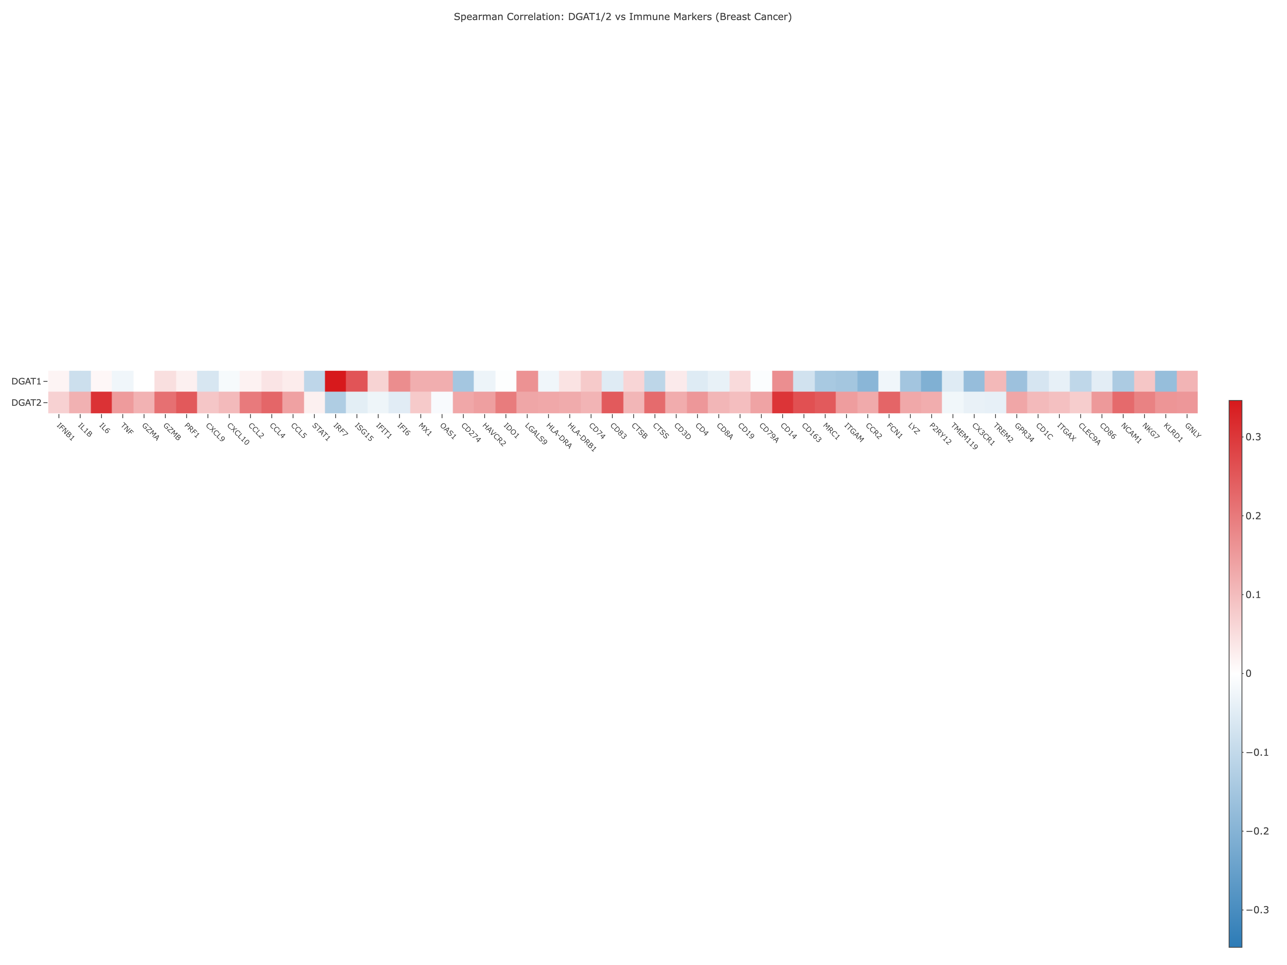
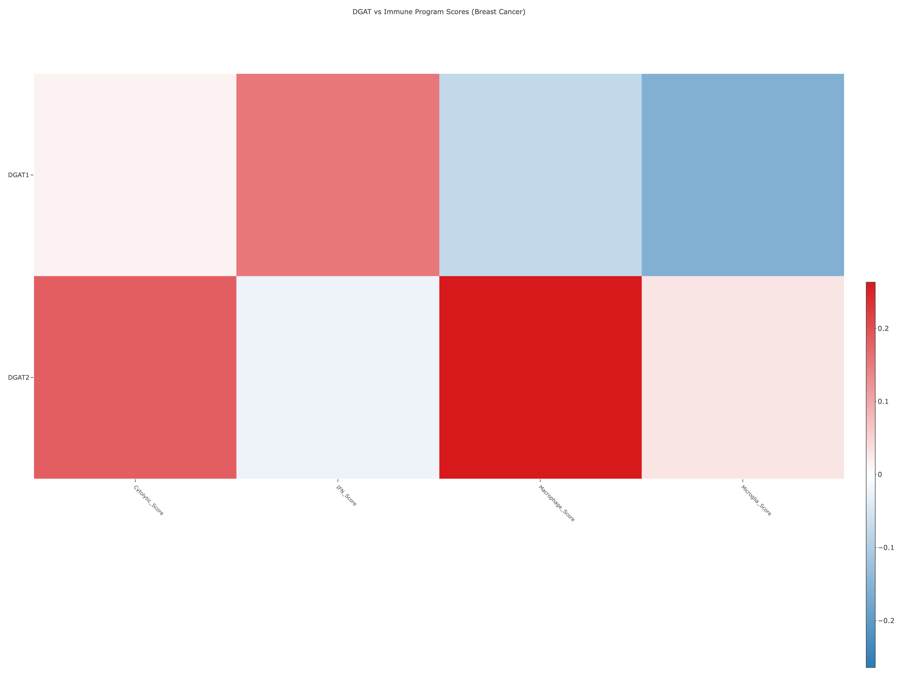
20250929

Slide 19
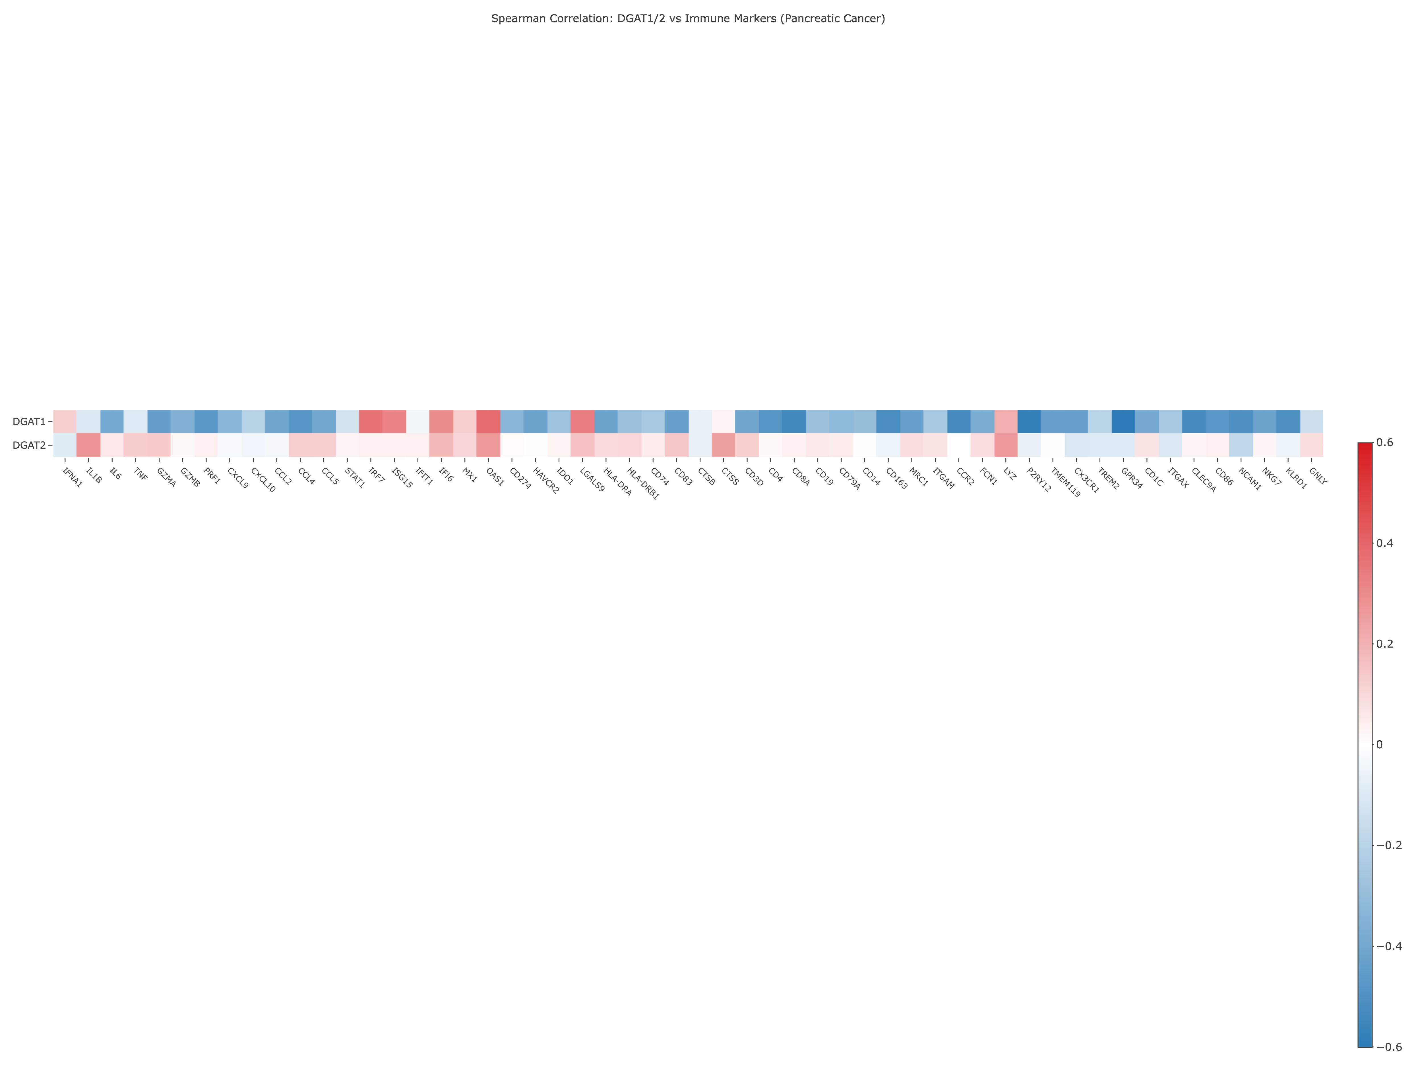
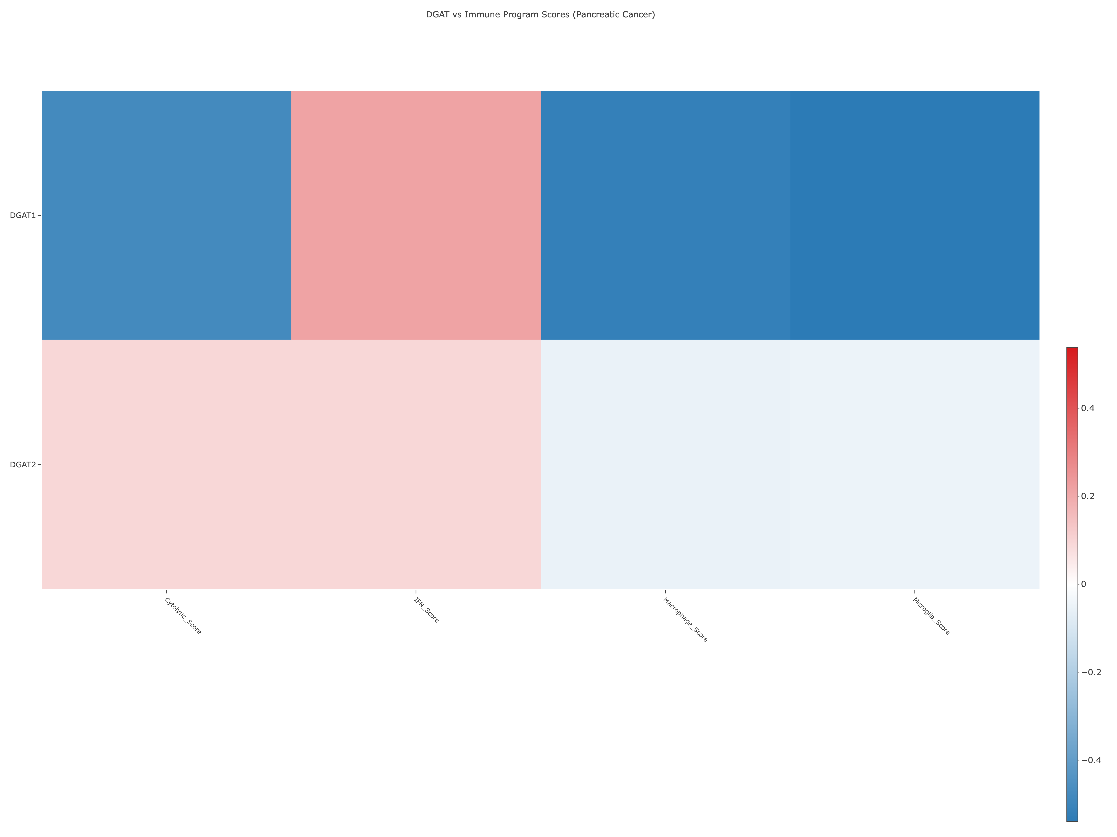
20250929

Slide 20
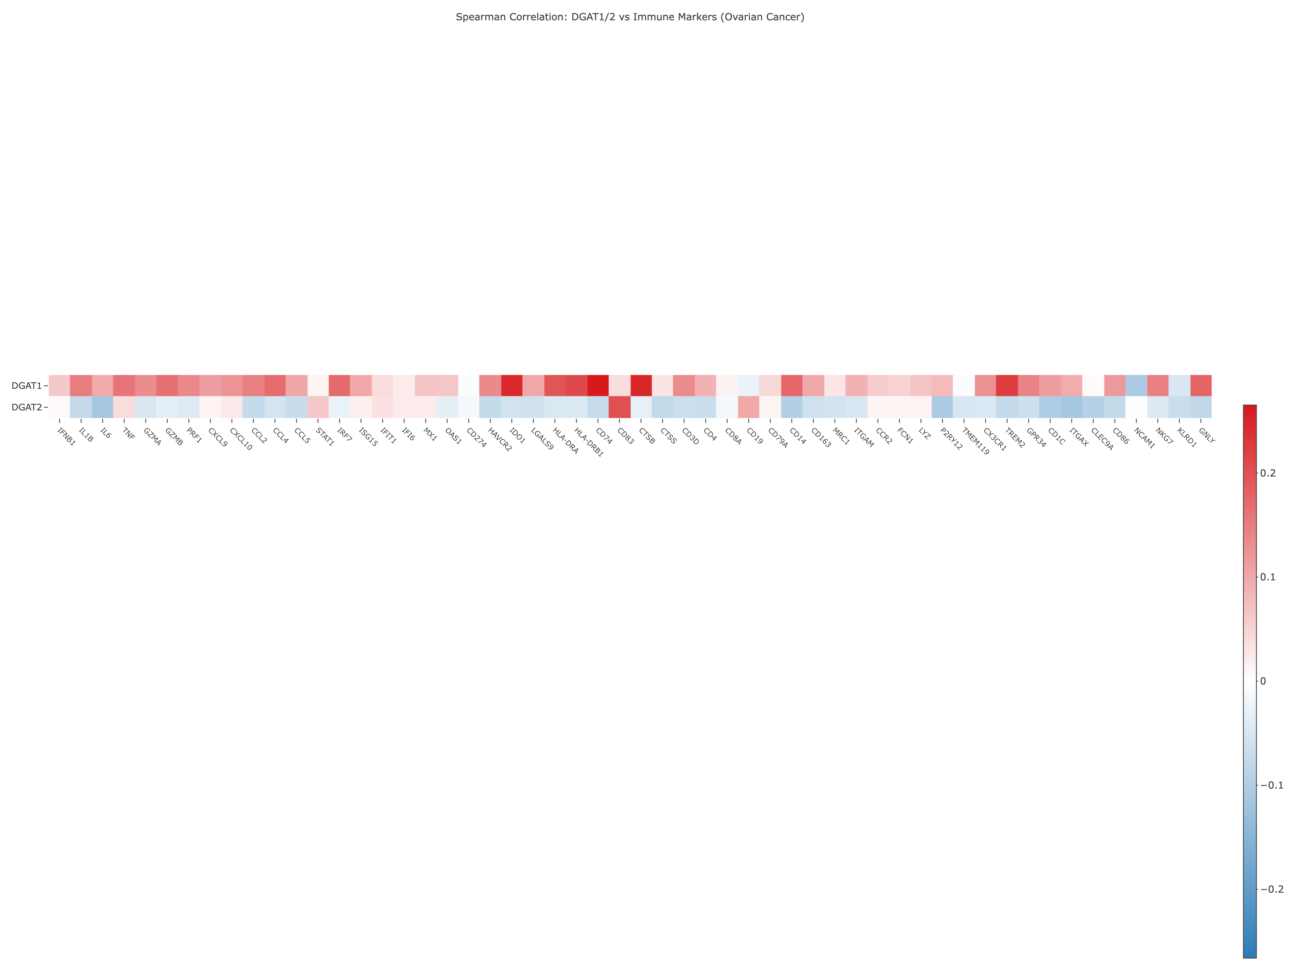
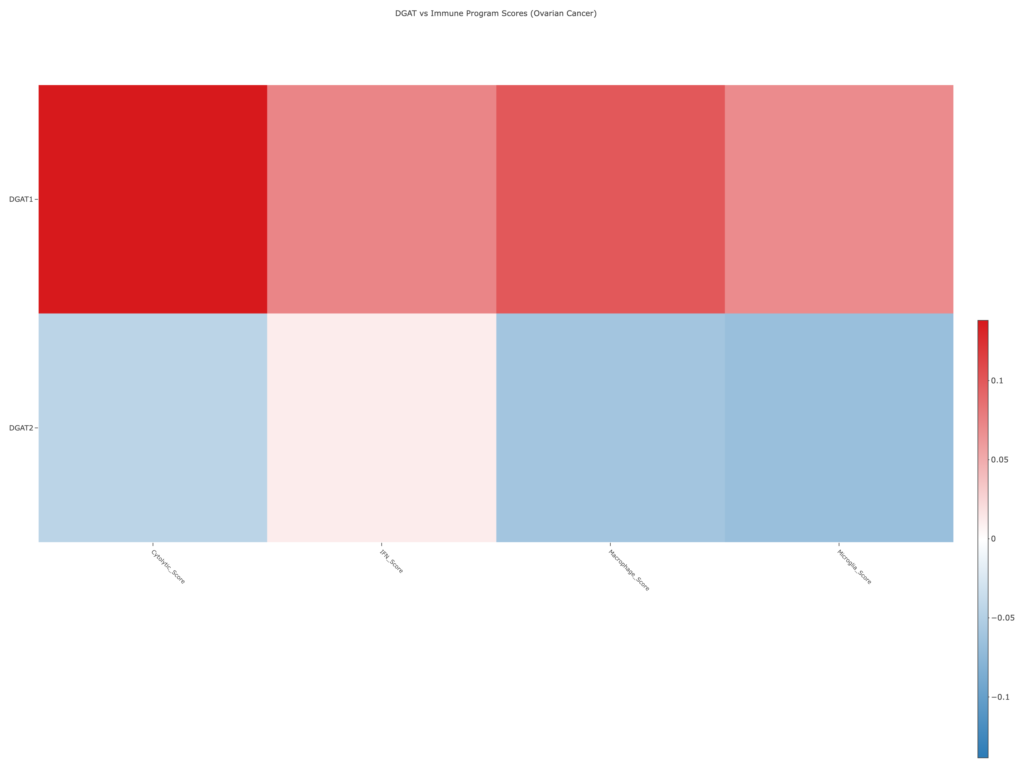
20250929

Slide 21
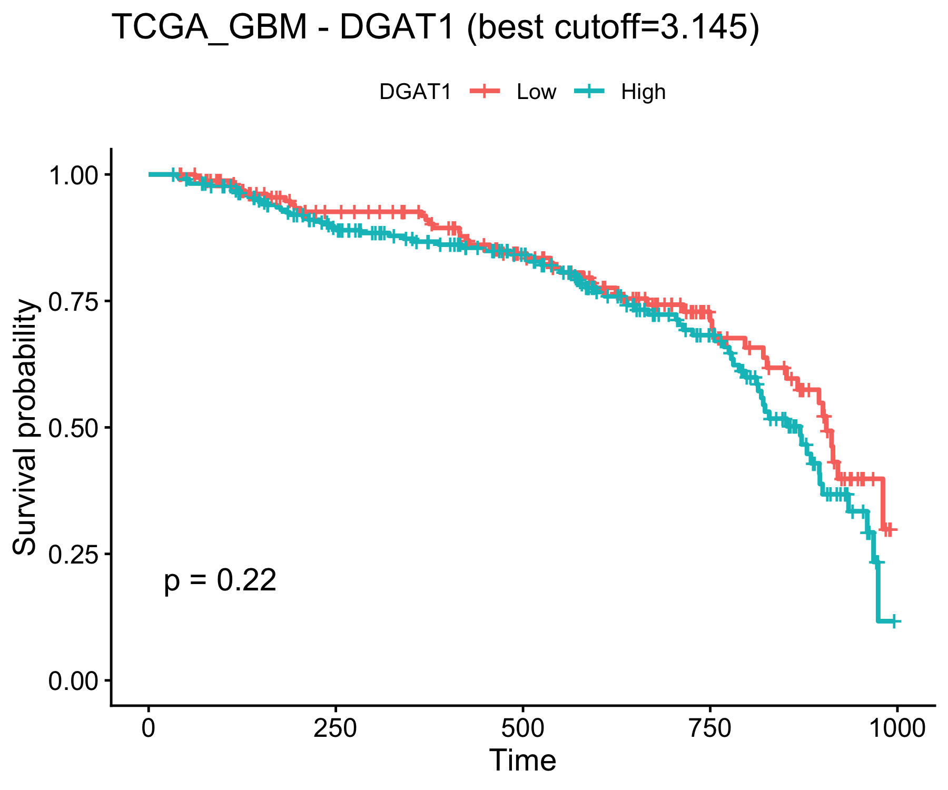
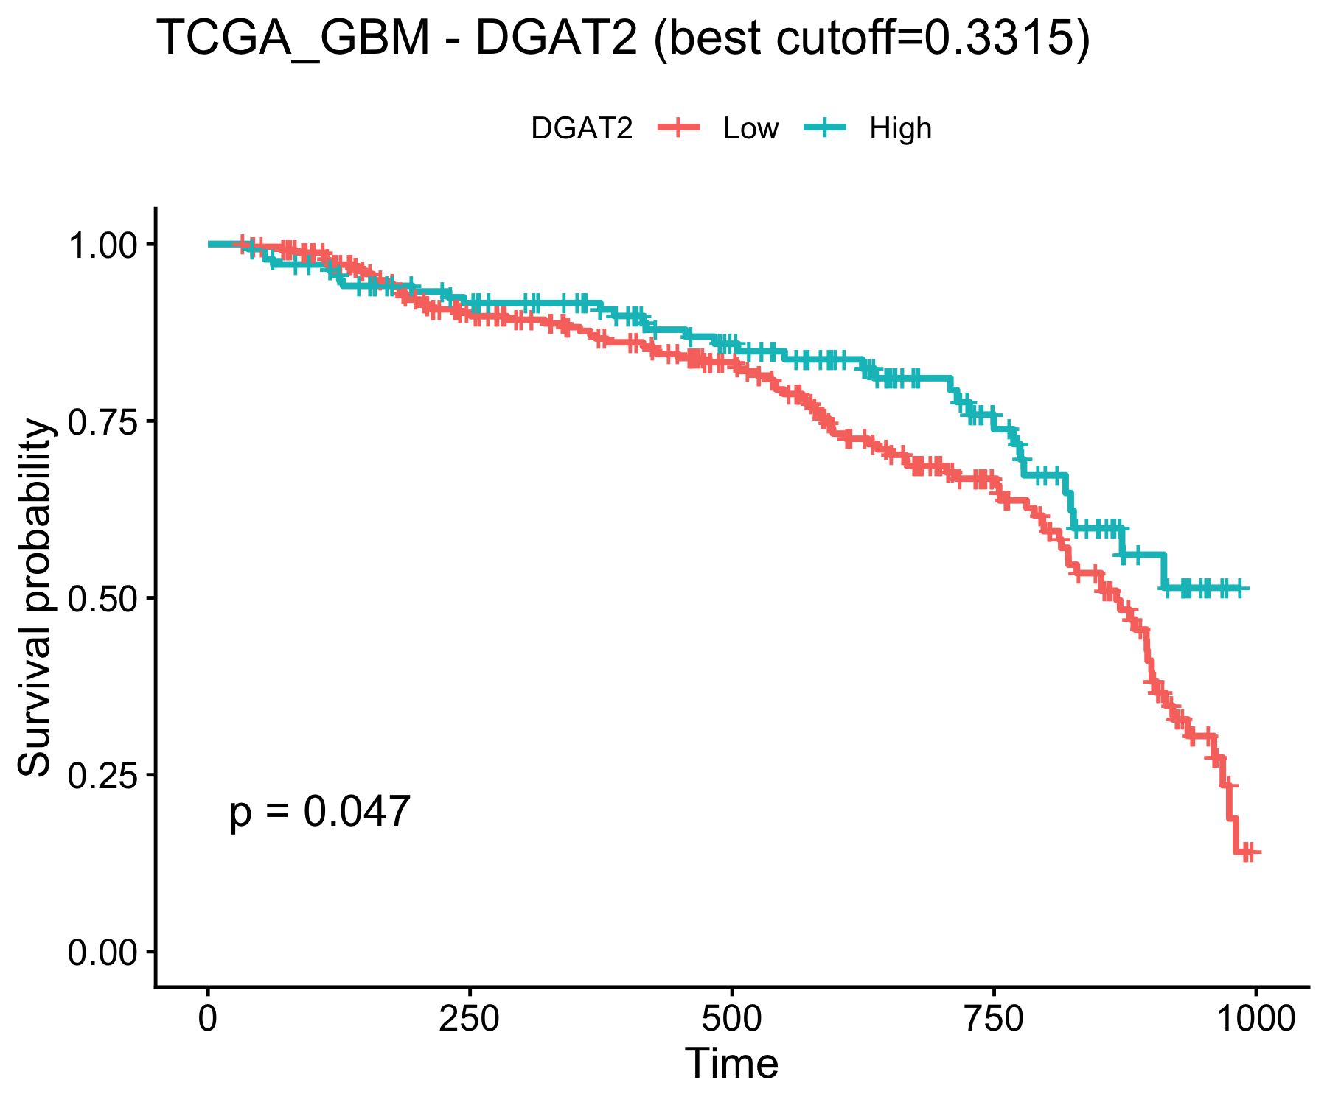

Slide 22
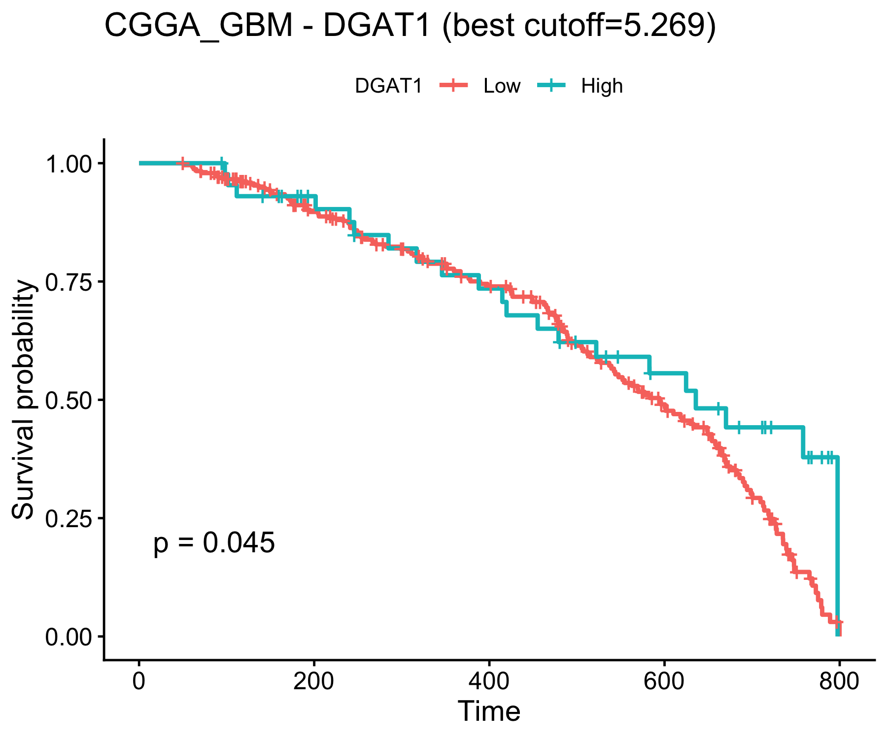
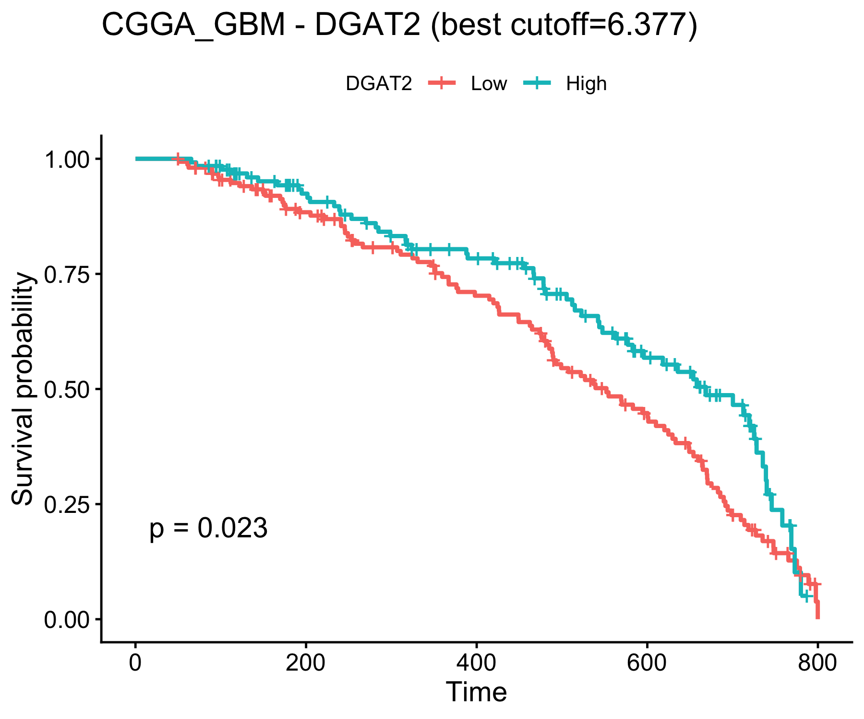

Slide 23
